Slide 1
Preparing Data

Slide 2
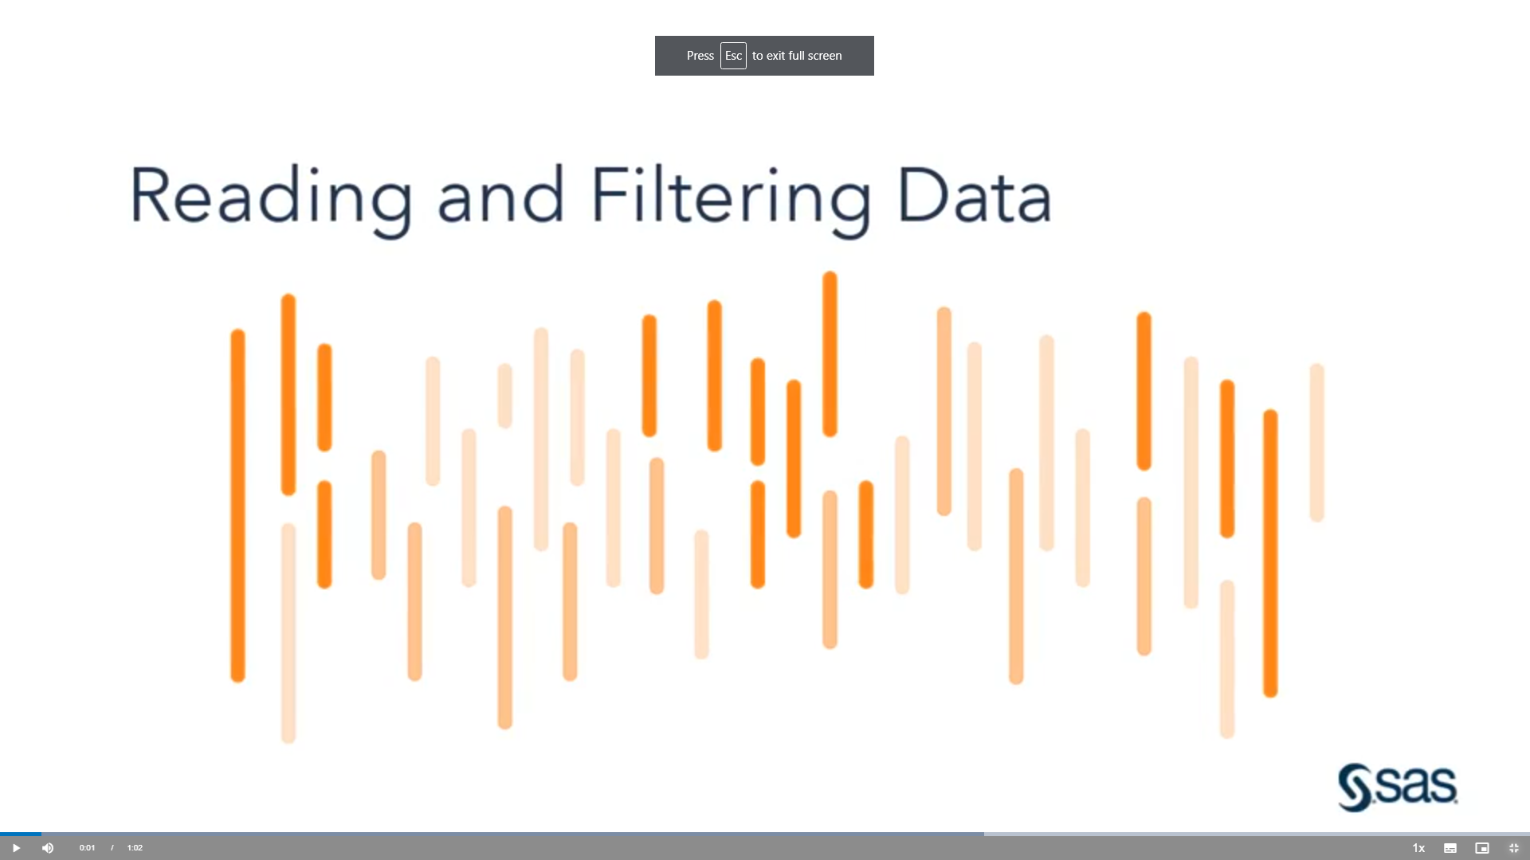
Using the DATA Step to Create a SAS Data Set

Slide 3
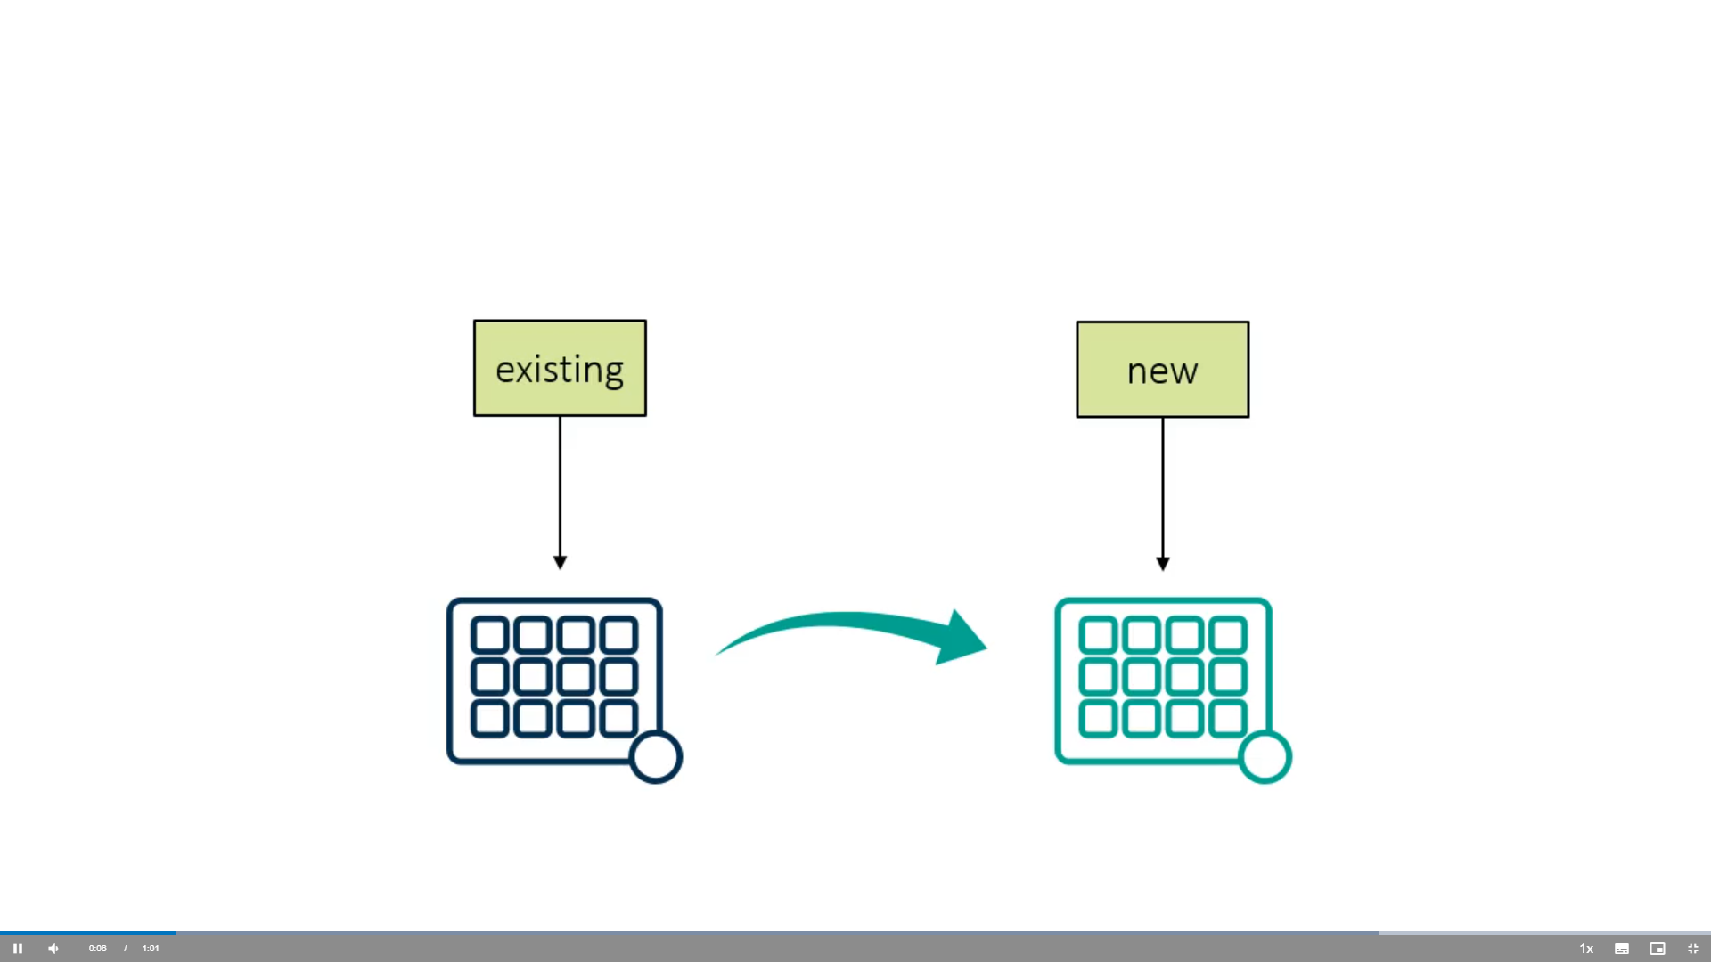

Slide 4
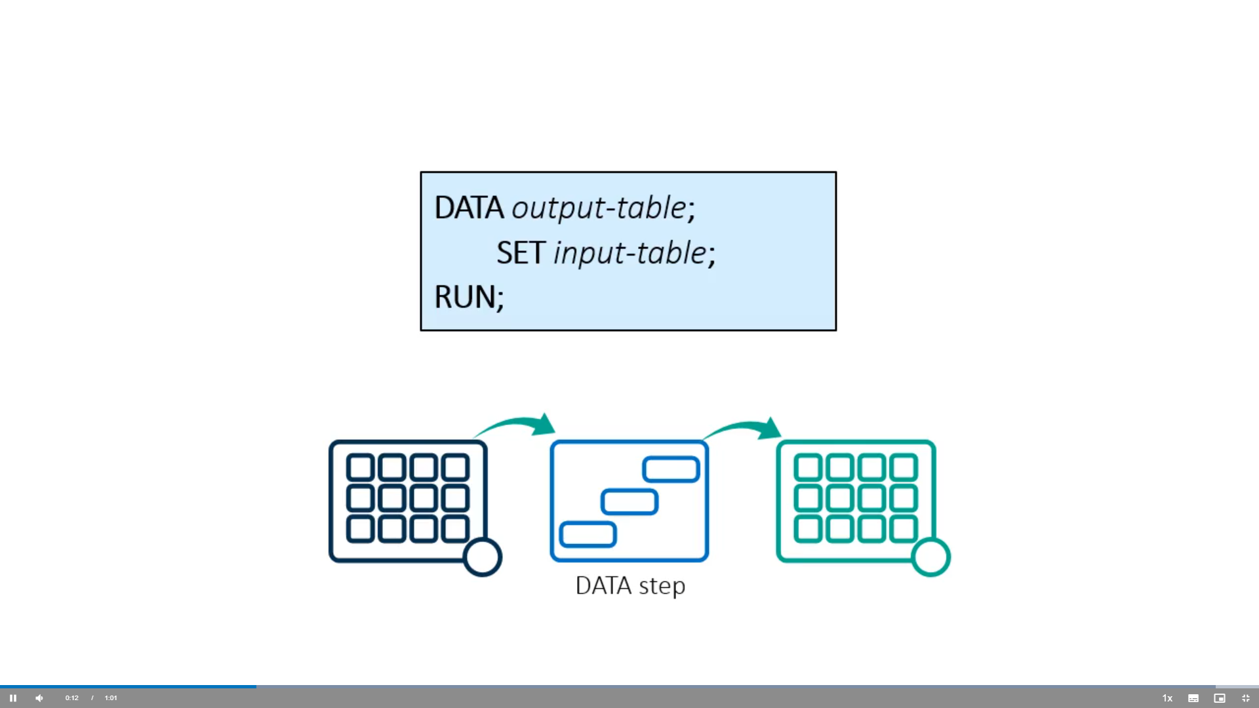

Slide 5
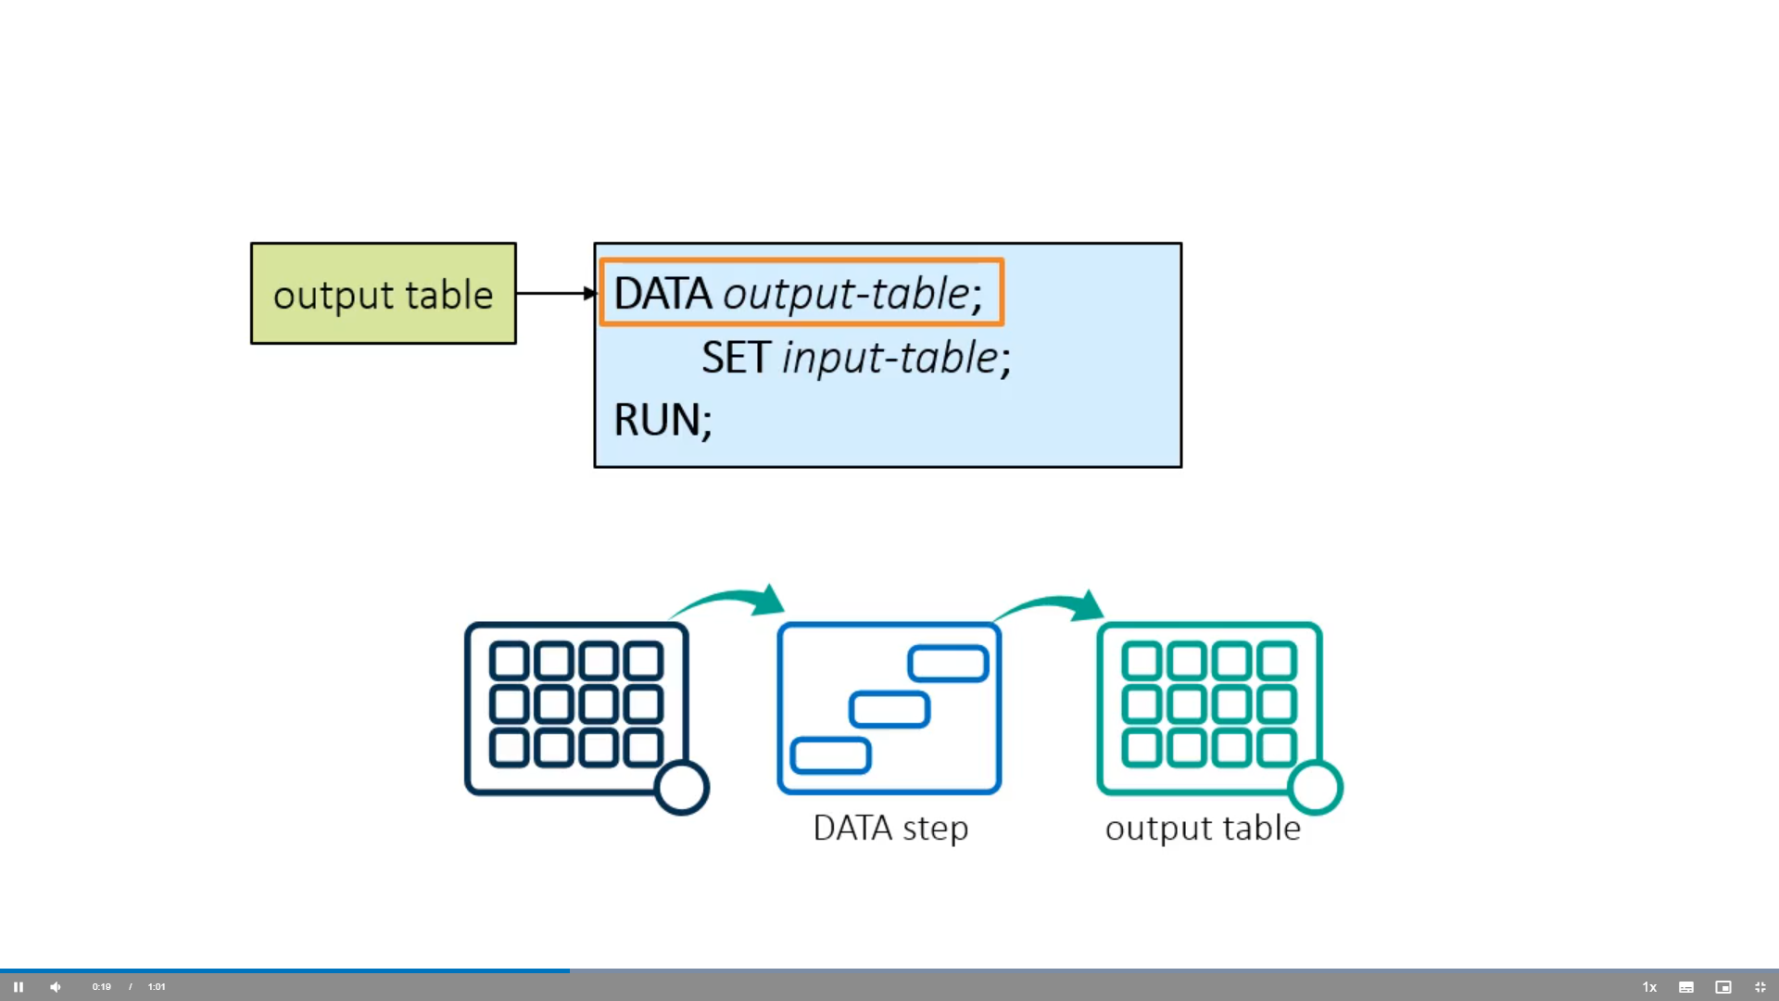

Slide 6
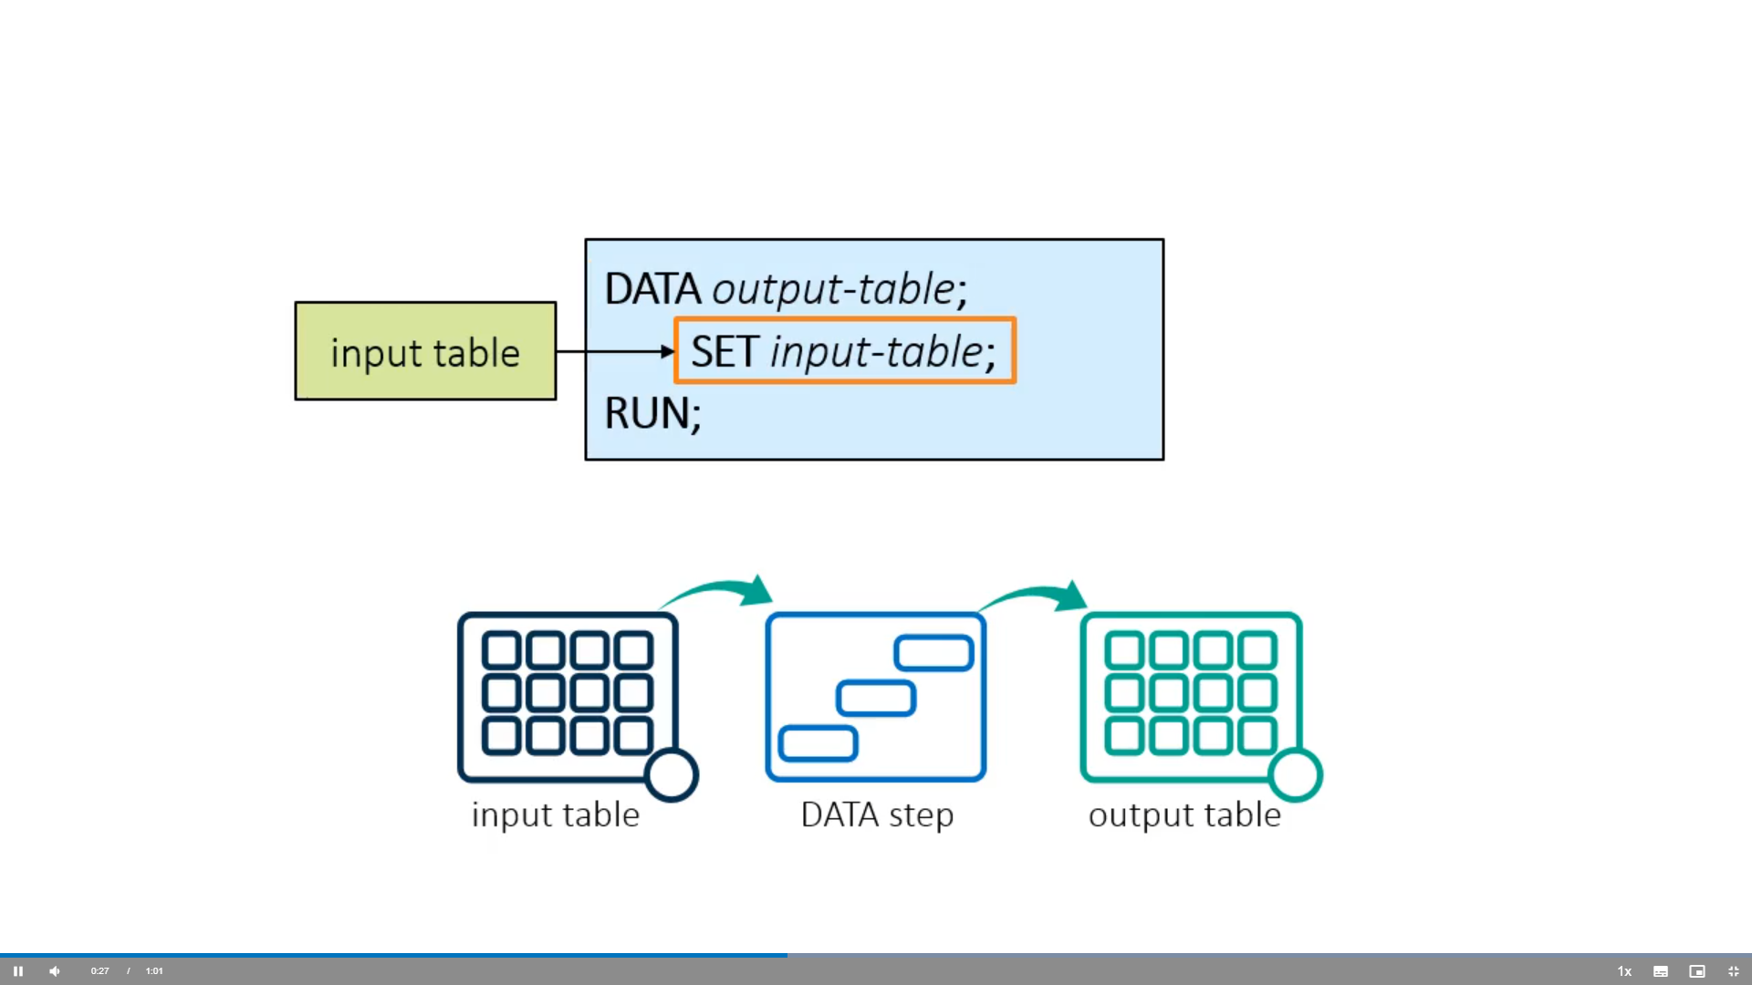

Slide 7
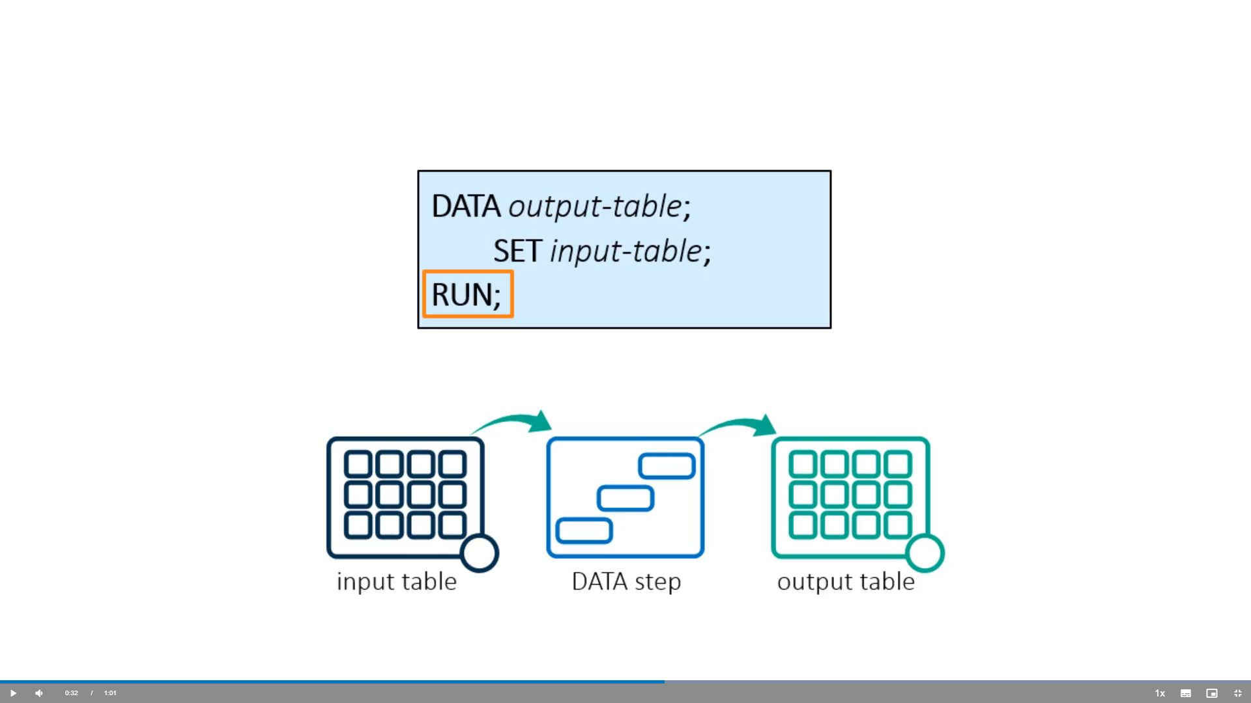

Slide 8
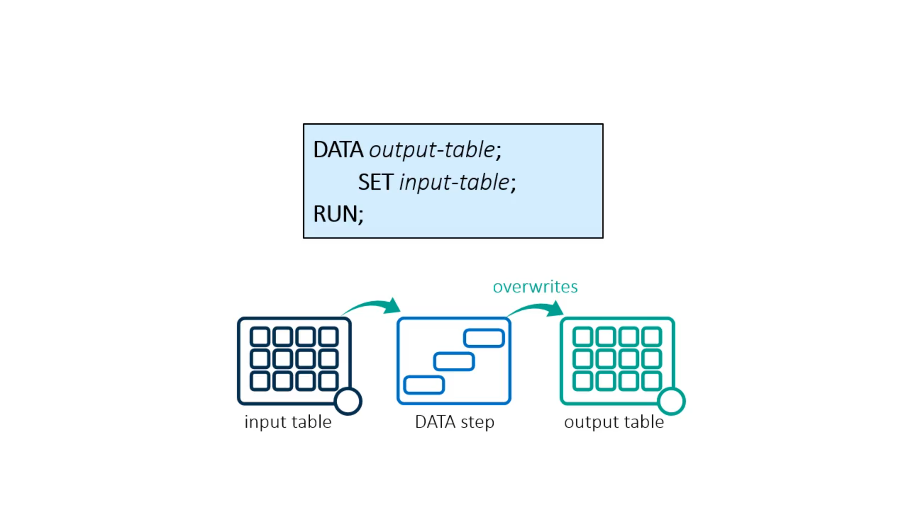

Slide 9
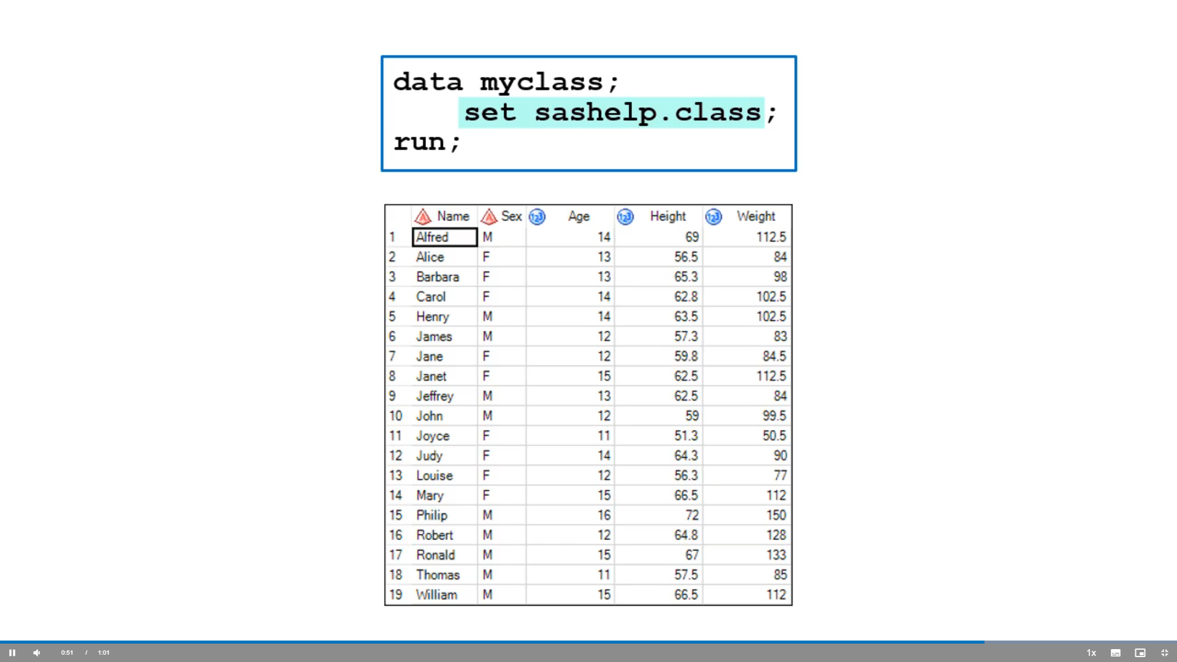

Slide 10
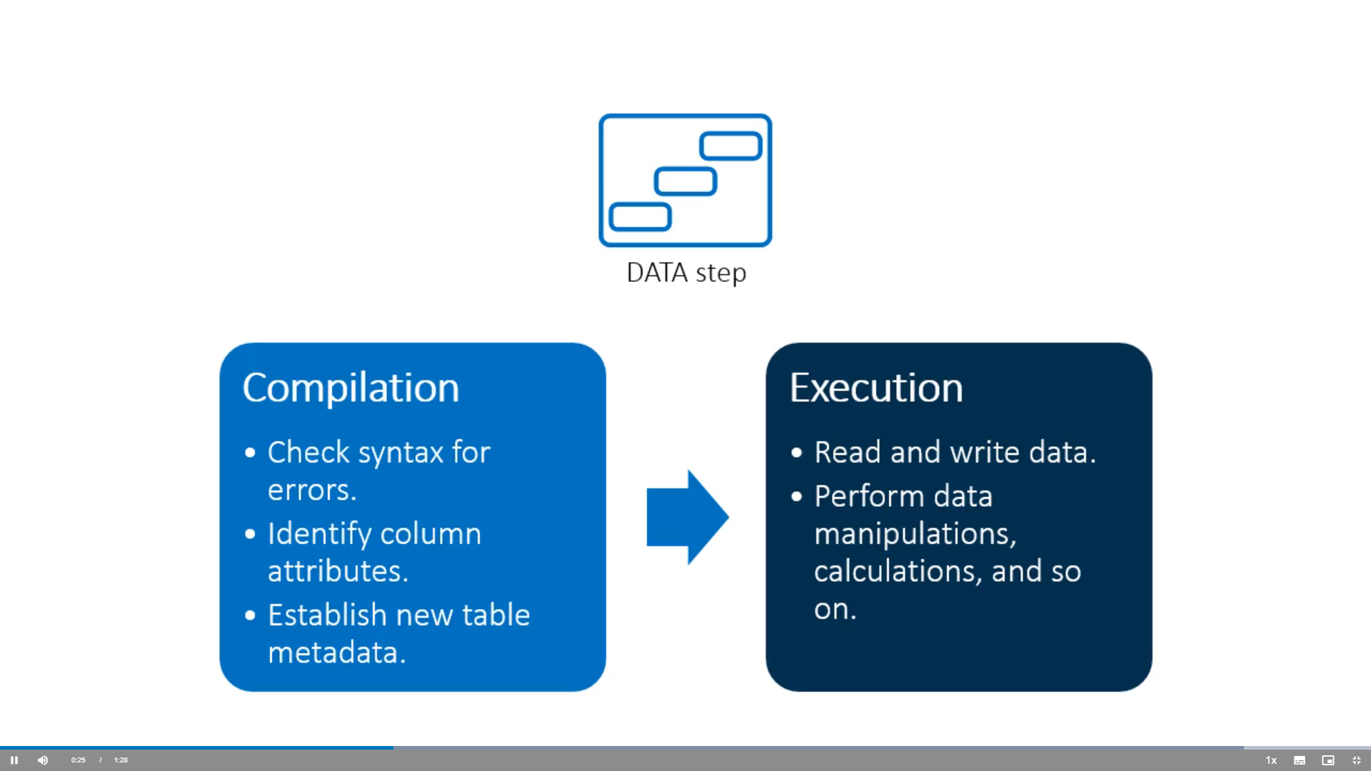
DATA Step Processing

Slide 11
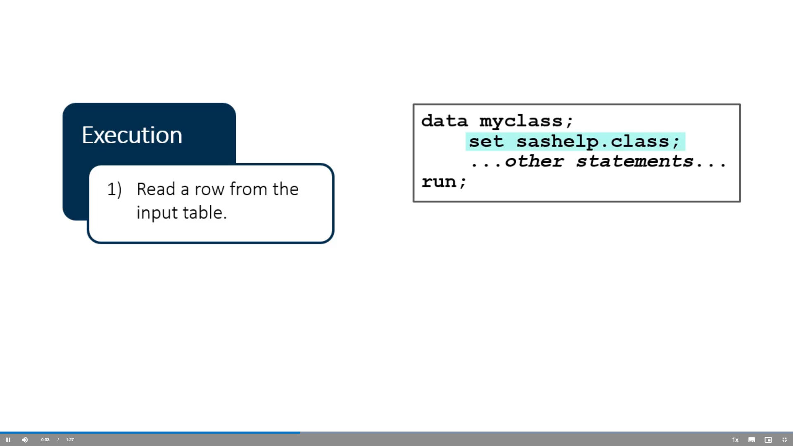

Slide 12
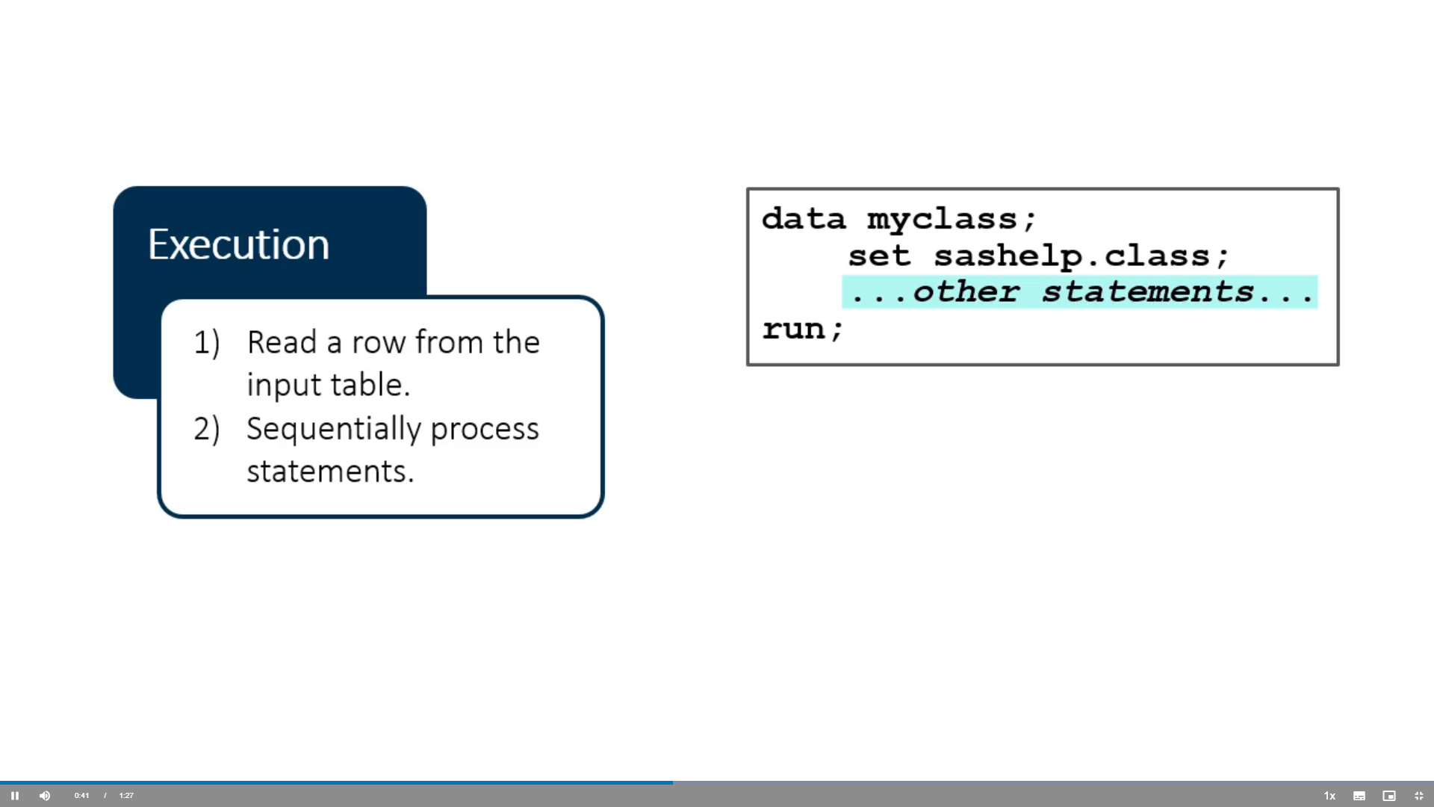

Slide 13
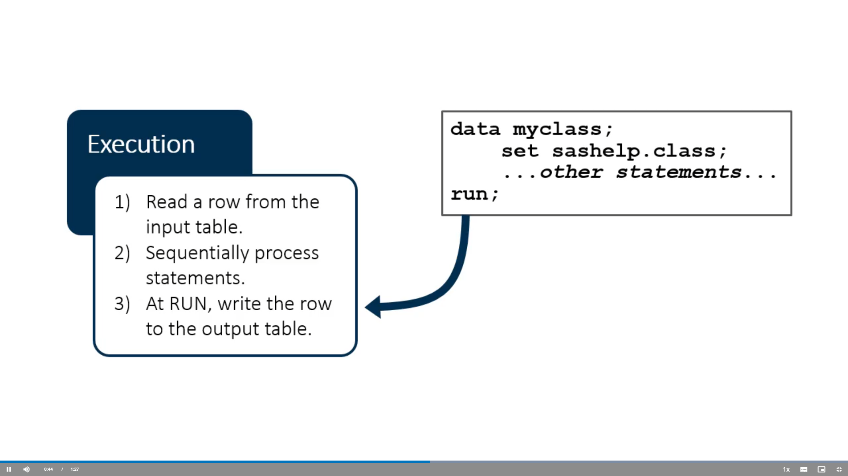

Slide 14
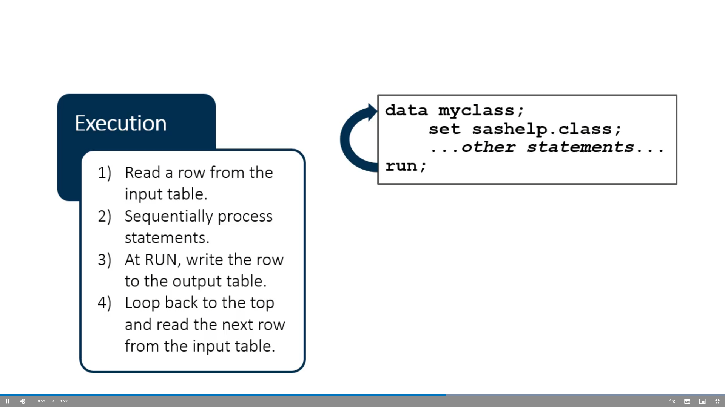

Slide 19
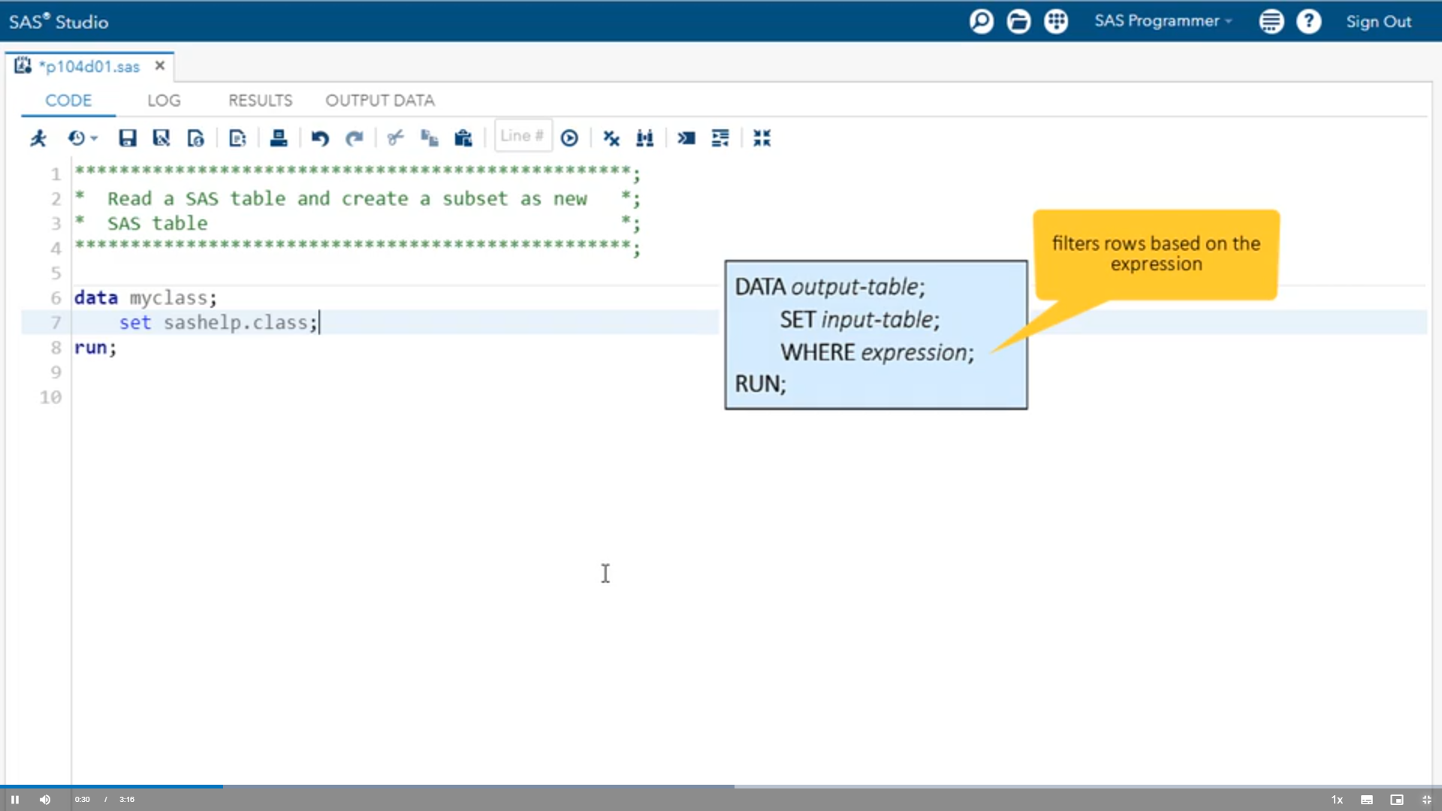
Demo: Working with the DATA Step

Slide 20
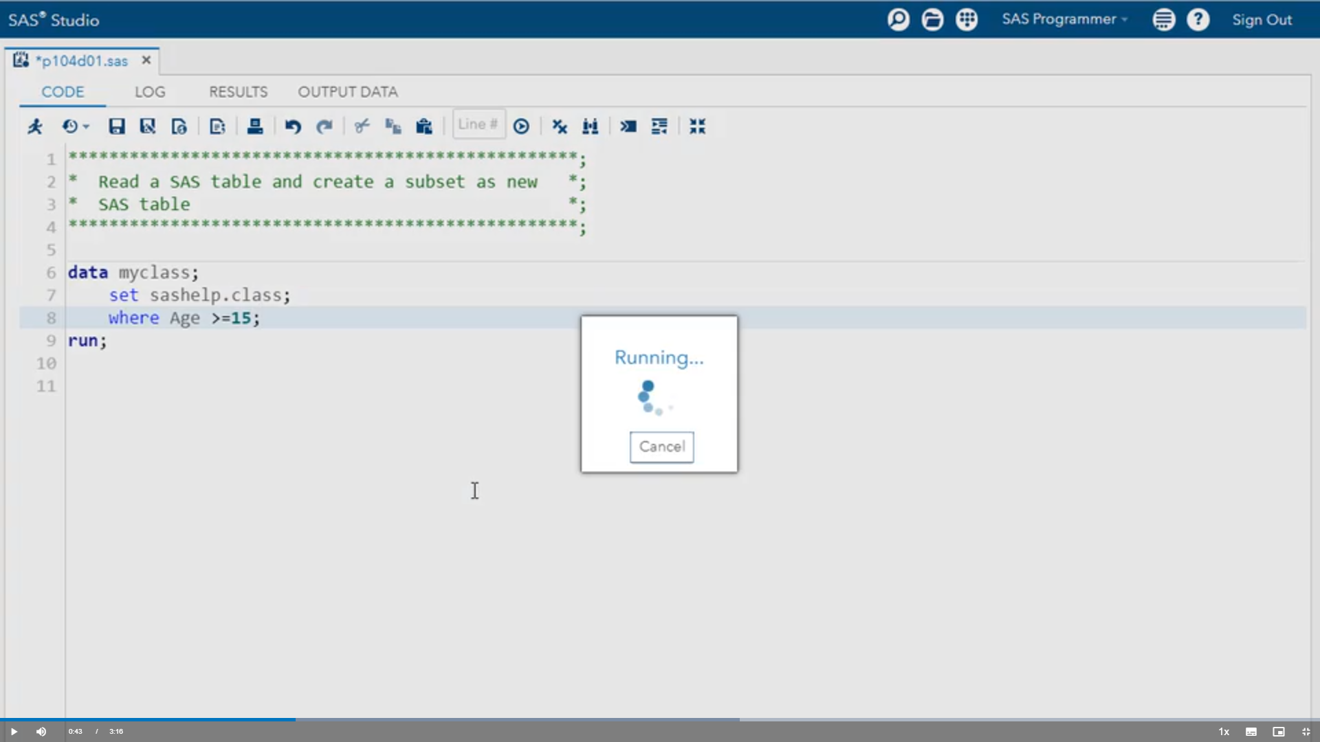

Slide 21
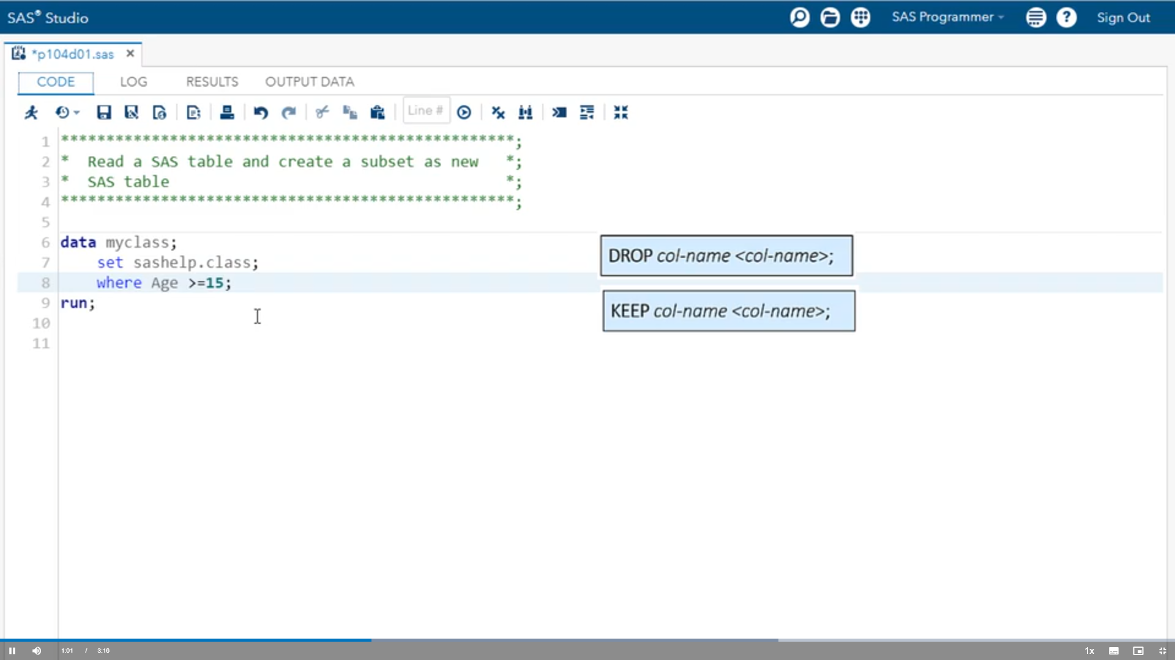

Slide 22
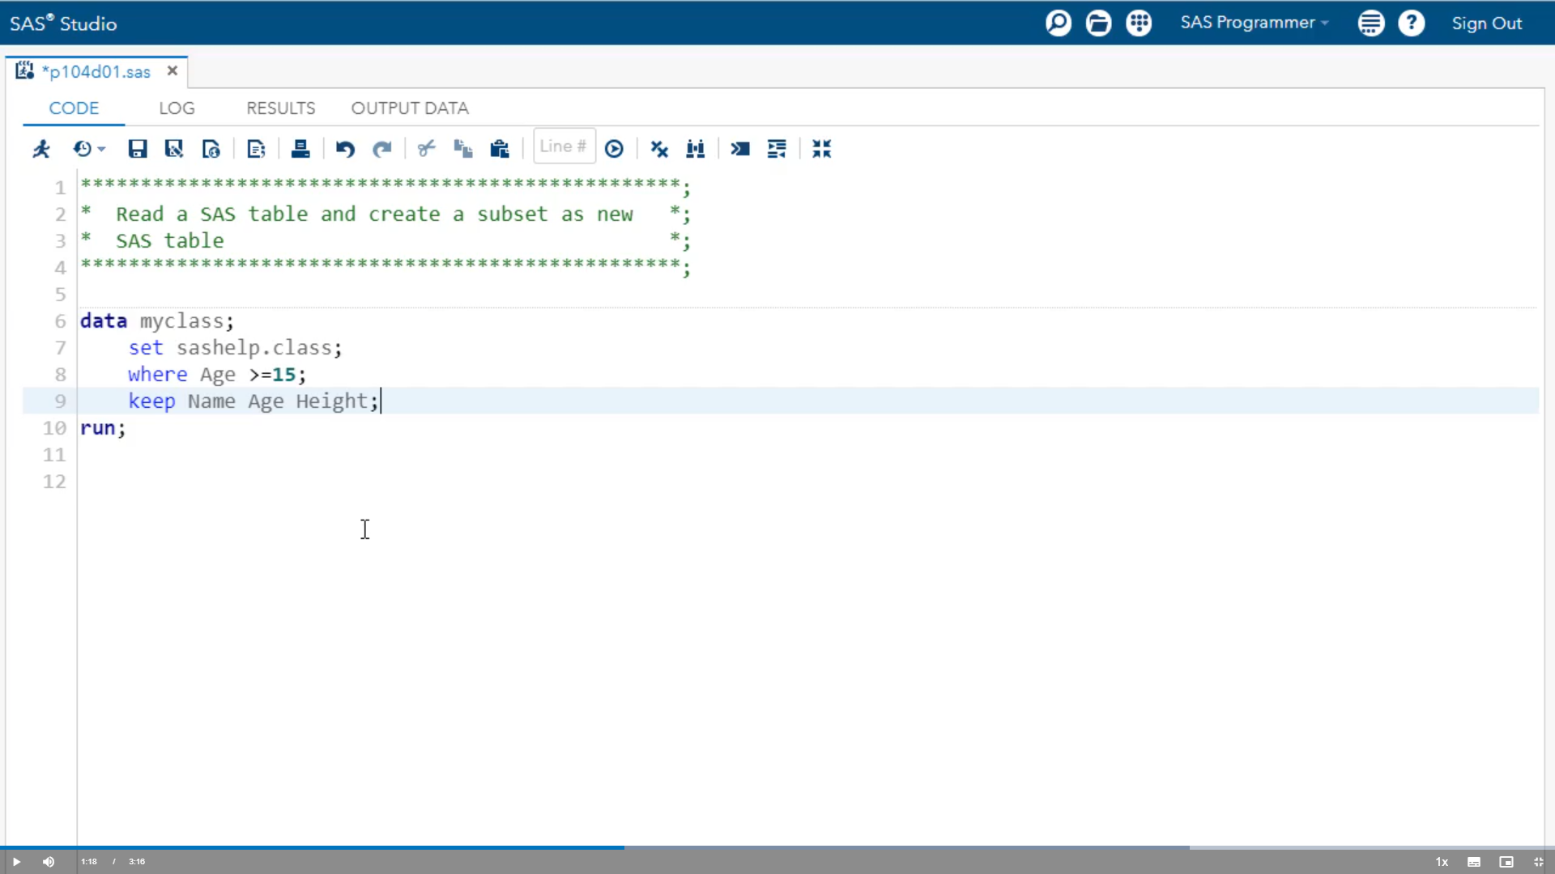

Slide 23
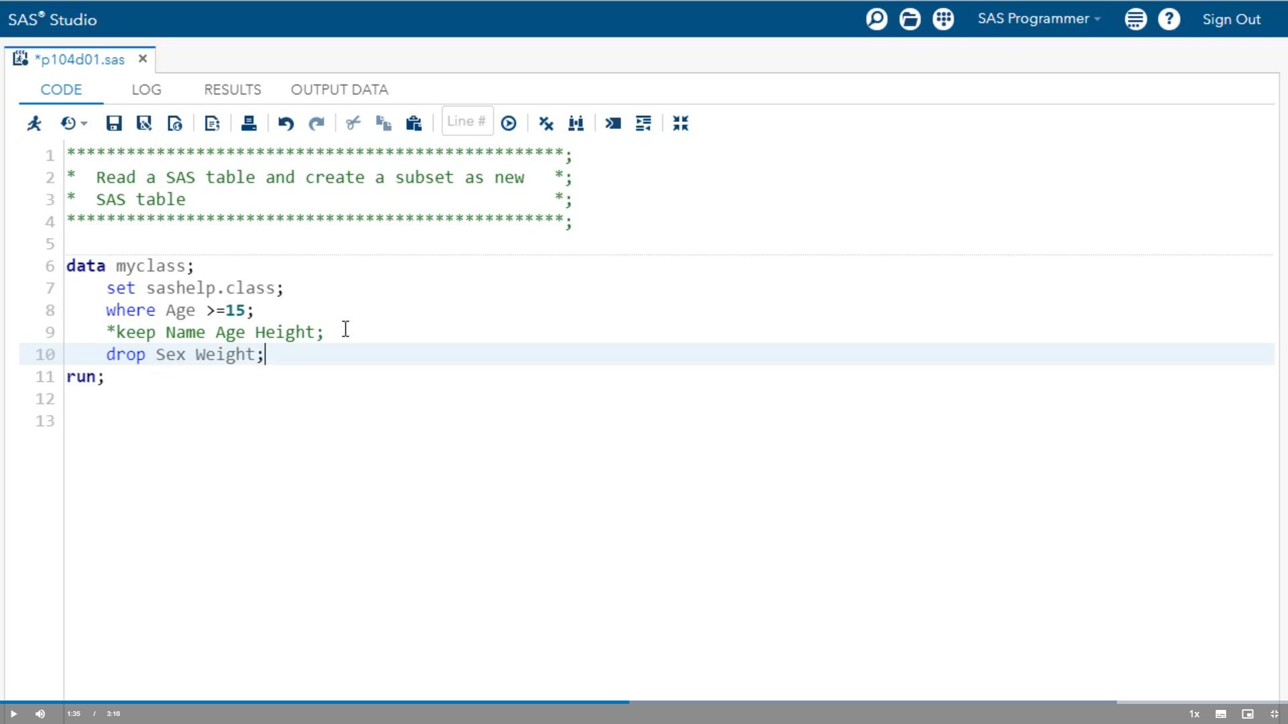

Slide 24
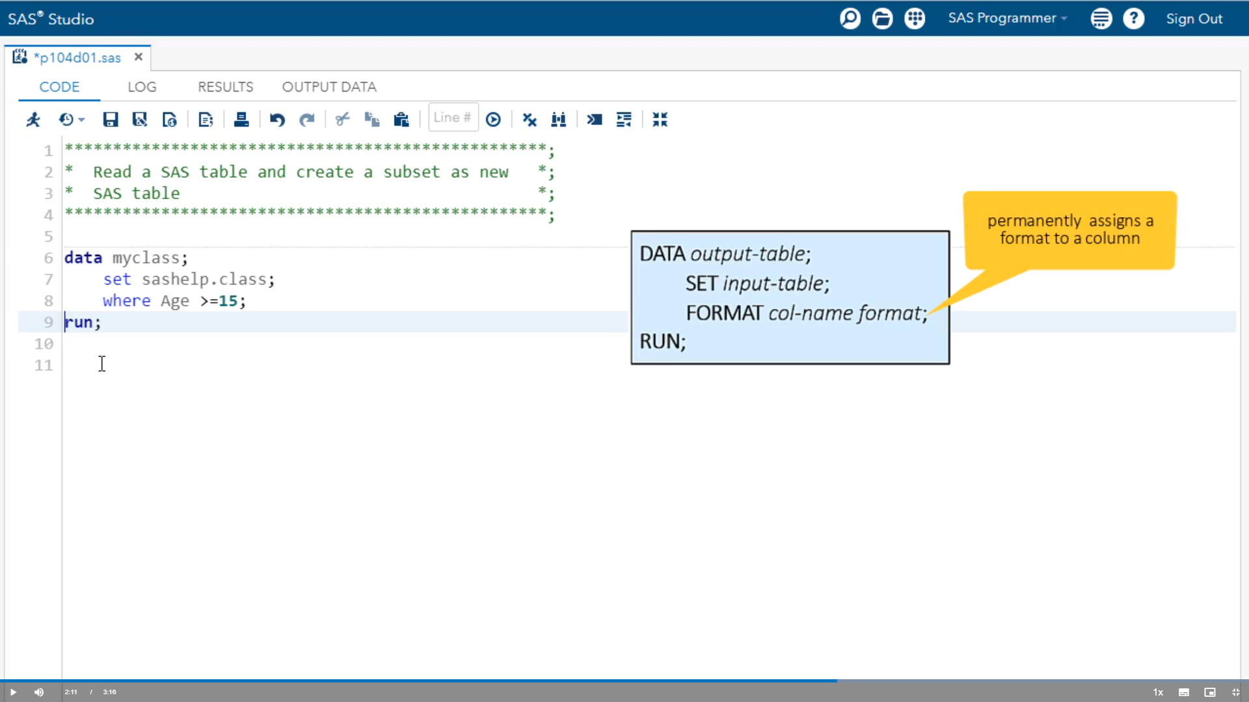

Slide 25
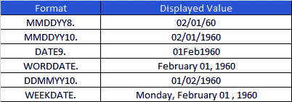

Slide 26
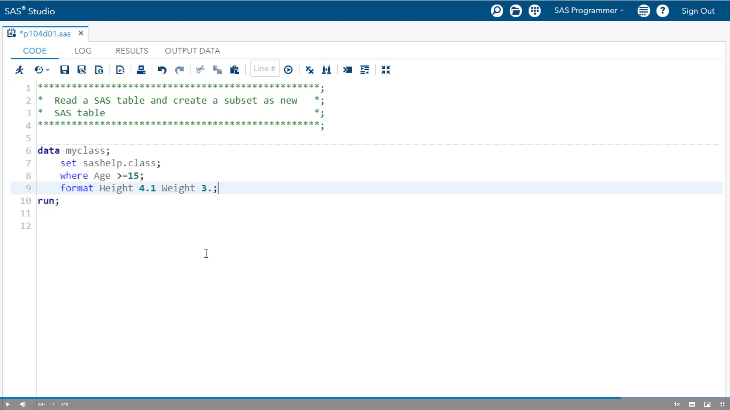

Slide 27
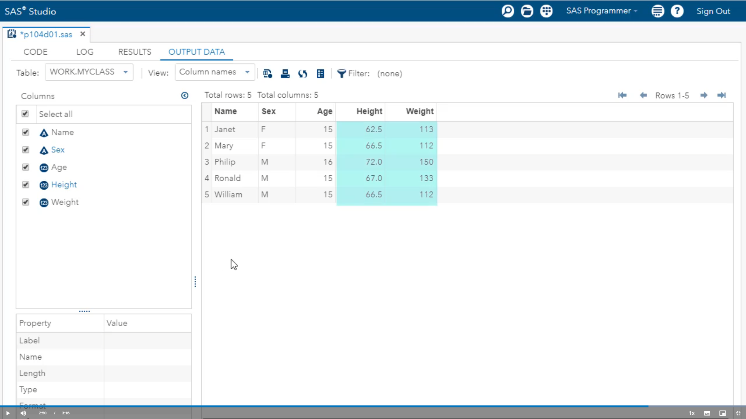

Slide 28
Activity:
In your SAS software, open a new program window and perform the following tasks:
Write a DATA step that reads the XLSTROM.Storm_summary table and creates an output table named Storm_cat5. Note: If you are using SAS Studio, try creating storm_cat5 as a permanent table in (output ) folder.
Include only Category 5 storms (MaxWindMPH greater than or equal to 156) with StartDate on or after 01JAN2000.
Add a statement to include the following columns in the output data: Season, Basin, Name, Type, and MaxWindMPH.
How many Category 5 storms have there been since January 1, 2000?

Slide 29
Answer:
data out.storm_cat5;
set XLSTROM.Storm_summary;
where StartDate>="01jan2000"d and MaxWindMPH>=156;
keep Season Basin Name Type MaxWindMPH;
run;
There have been 18 Category 5 storms since January 1, 2000.
Note: To create storm_cat5 as a permanent table in the output folder, you would simply submit a LIBNAME statement to define a library and then reference the library on the DATA statement as in:
libname out "path-to-/output folder";
data out.storm_cat5;
. . .
run;

Slide 30
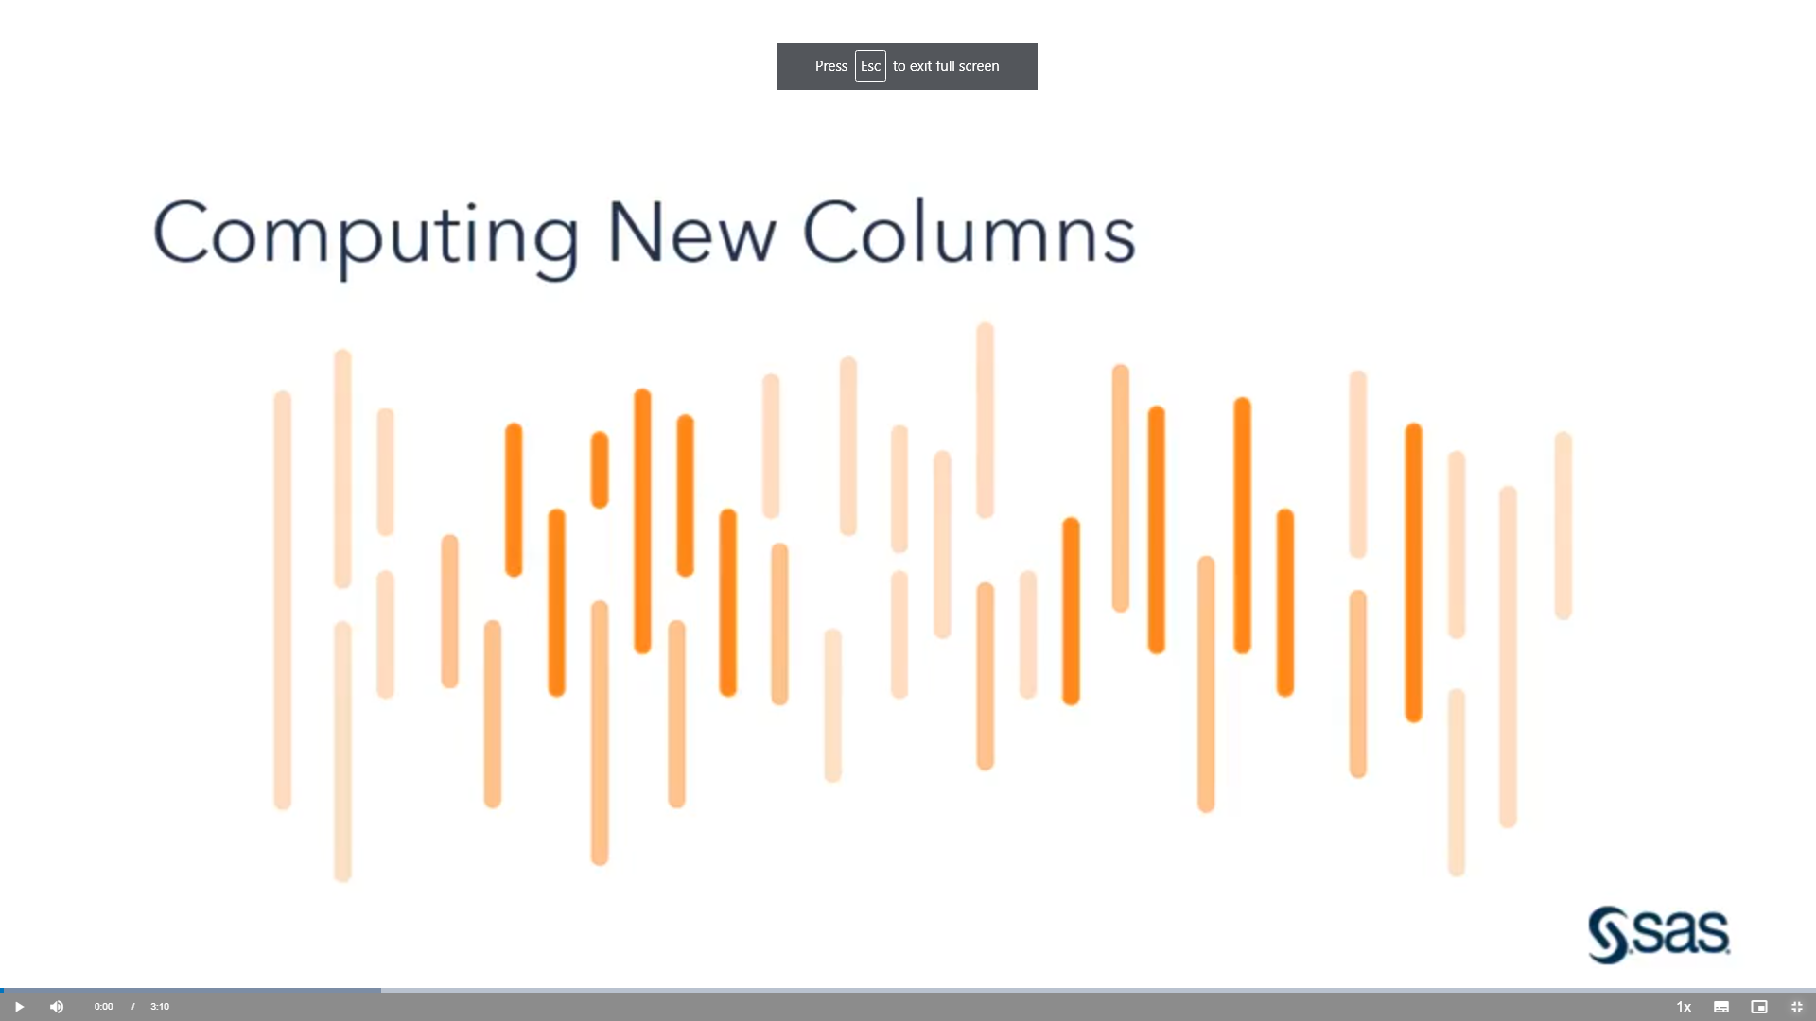
Demo: Using Expressions to Create New Columns

Slide 31
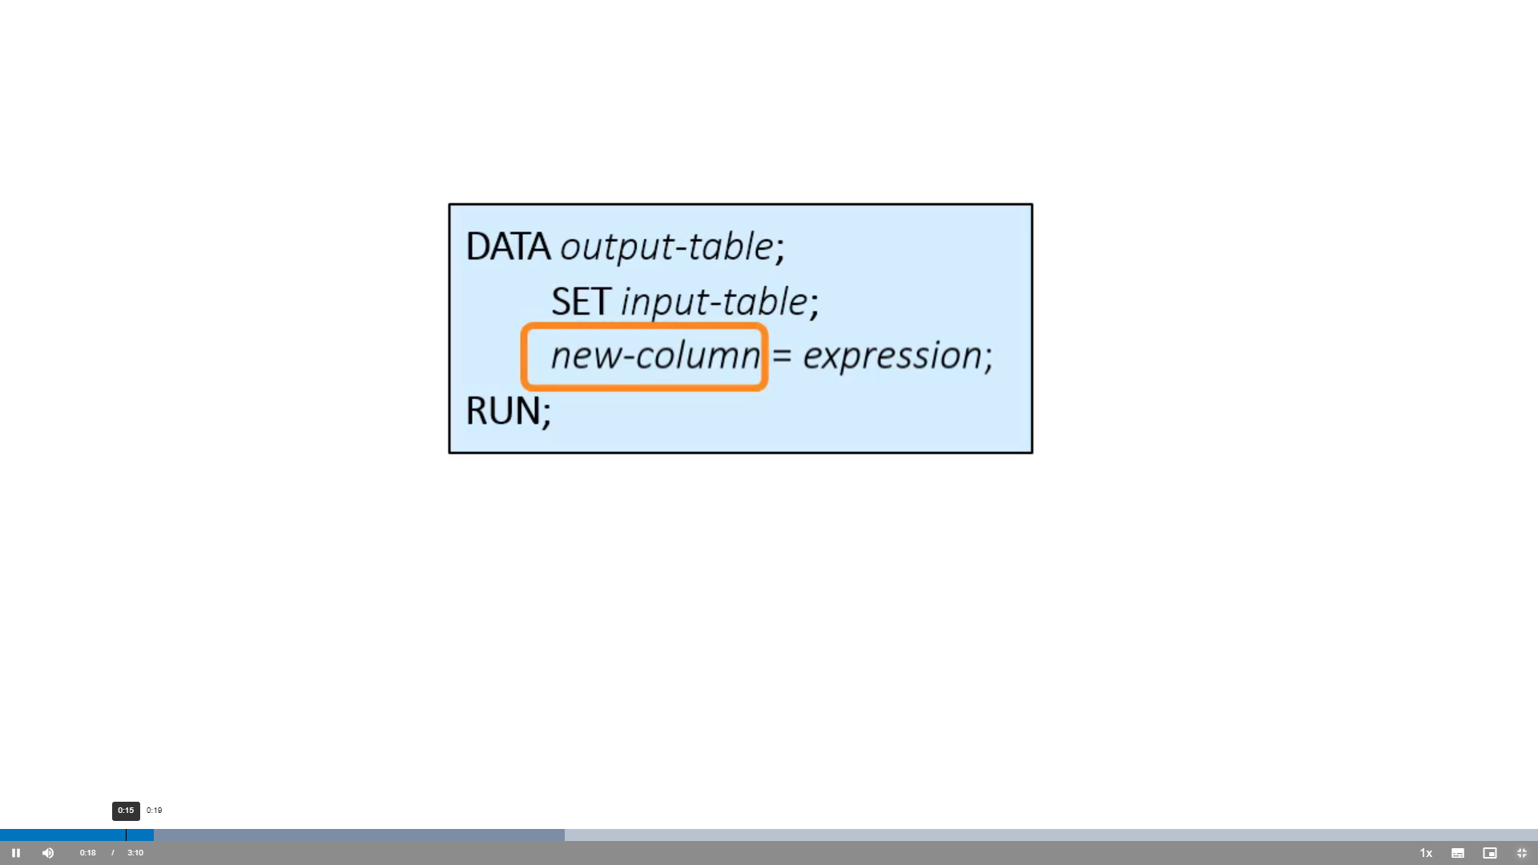

Slide 32
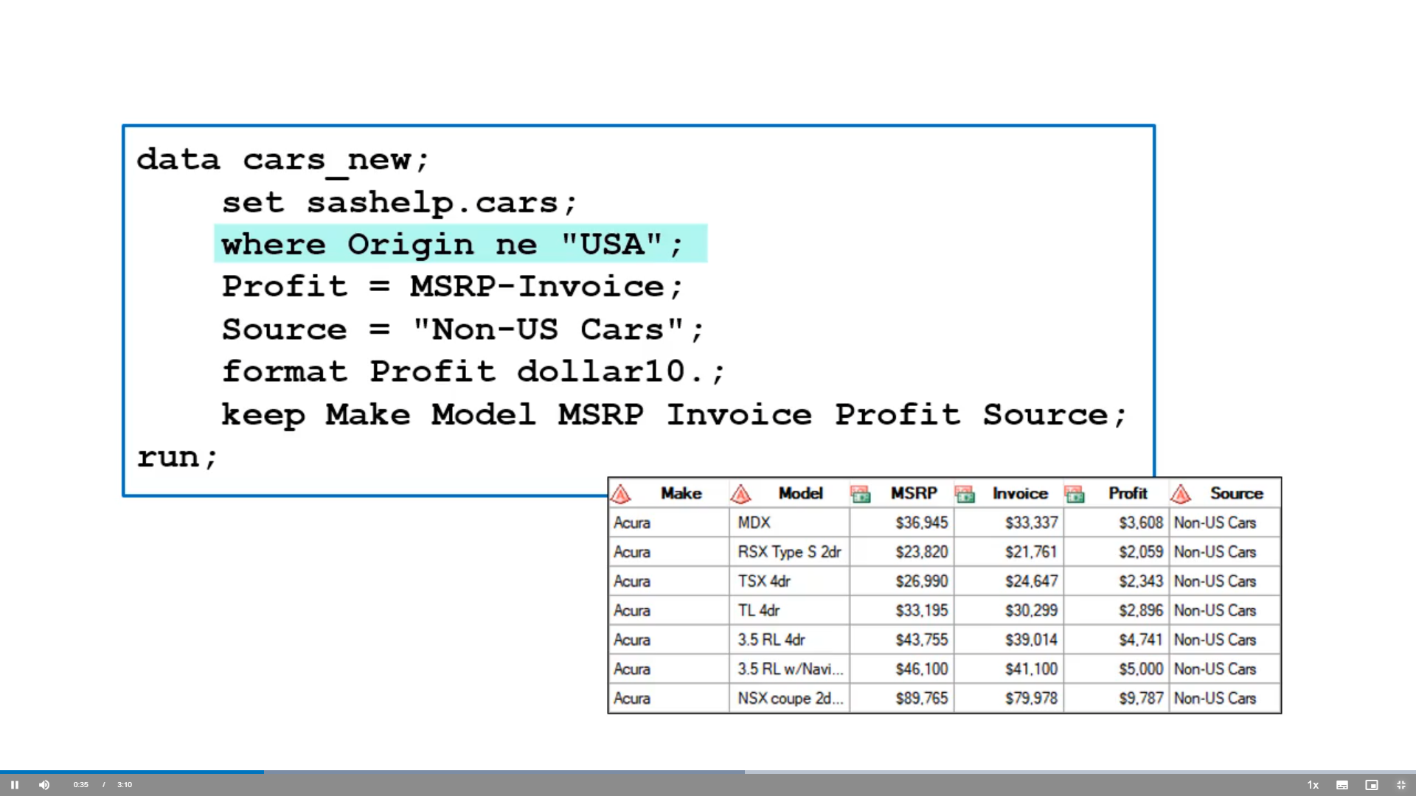

Slide 33
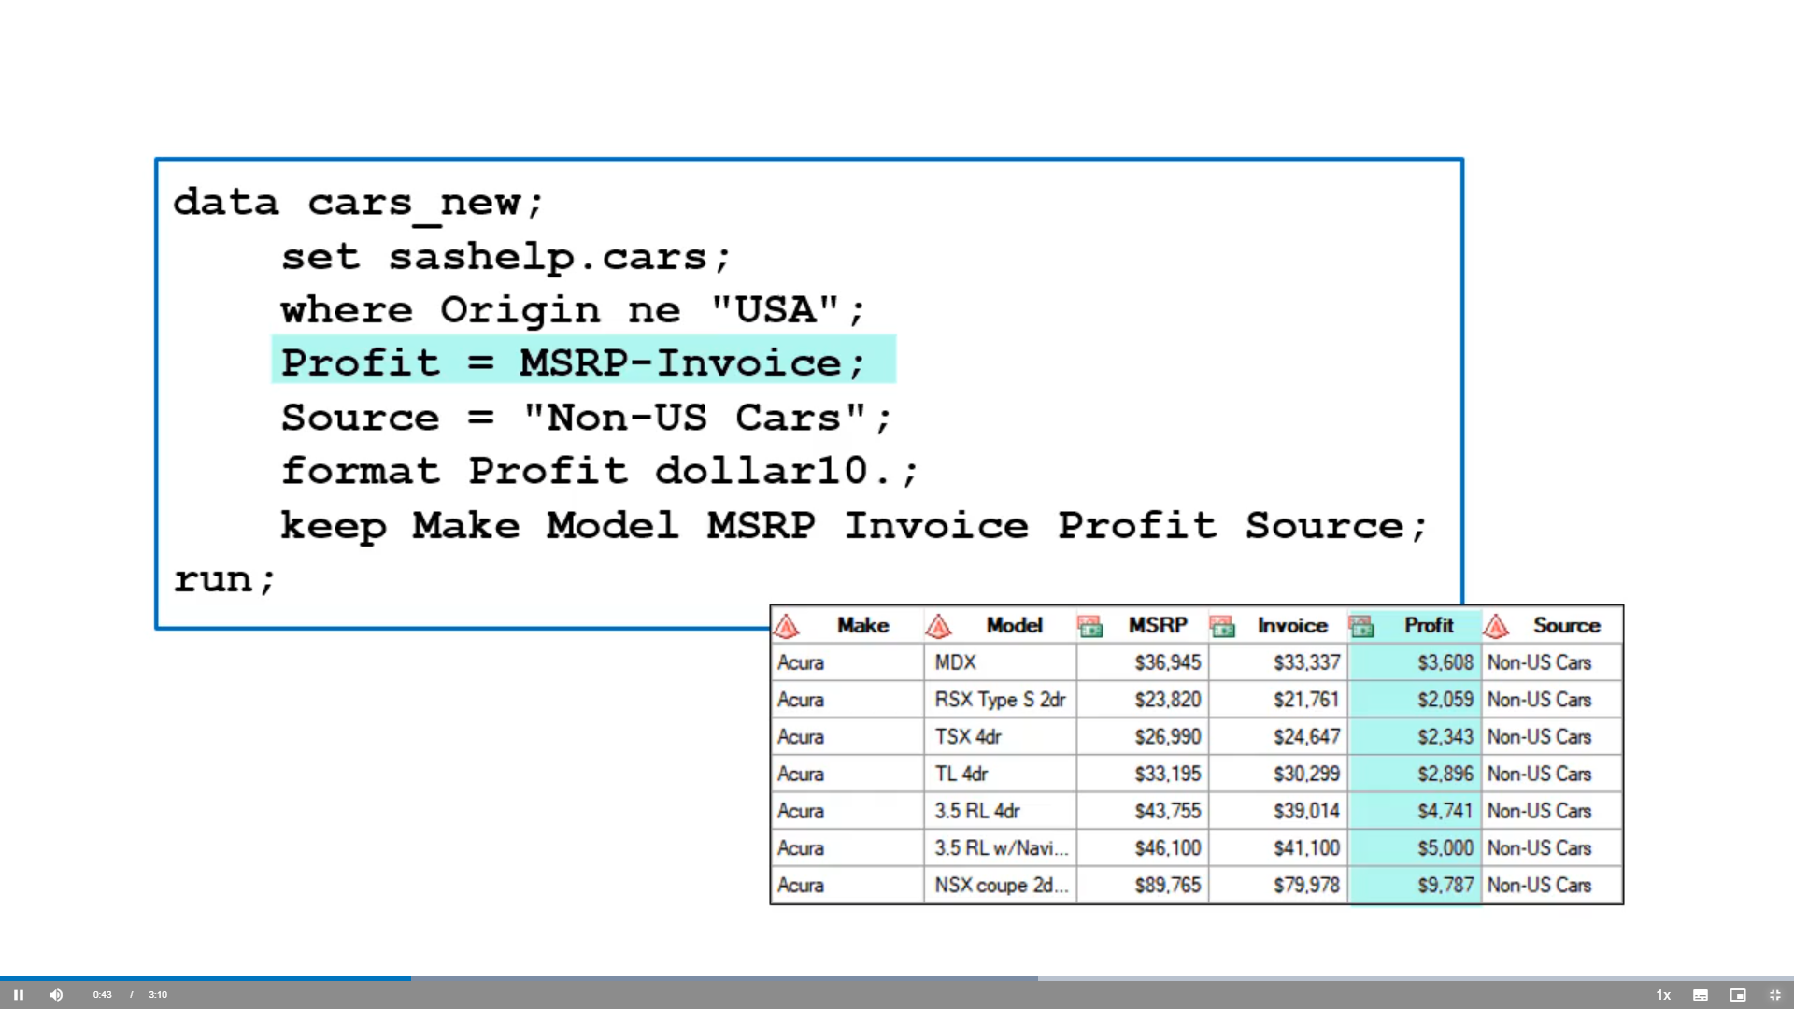

Slide 34
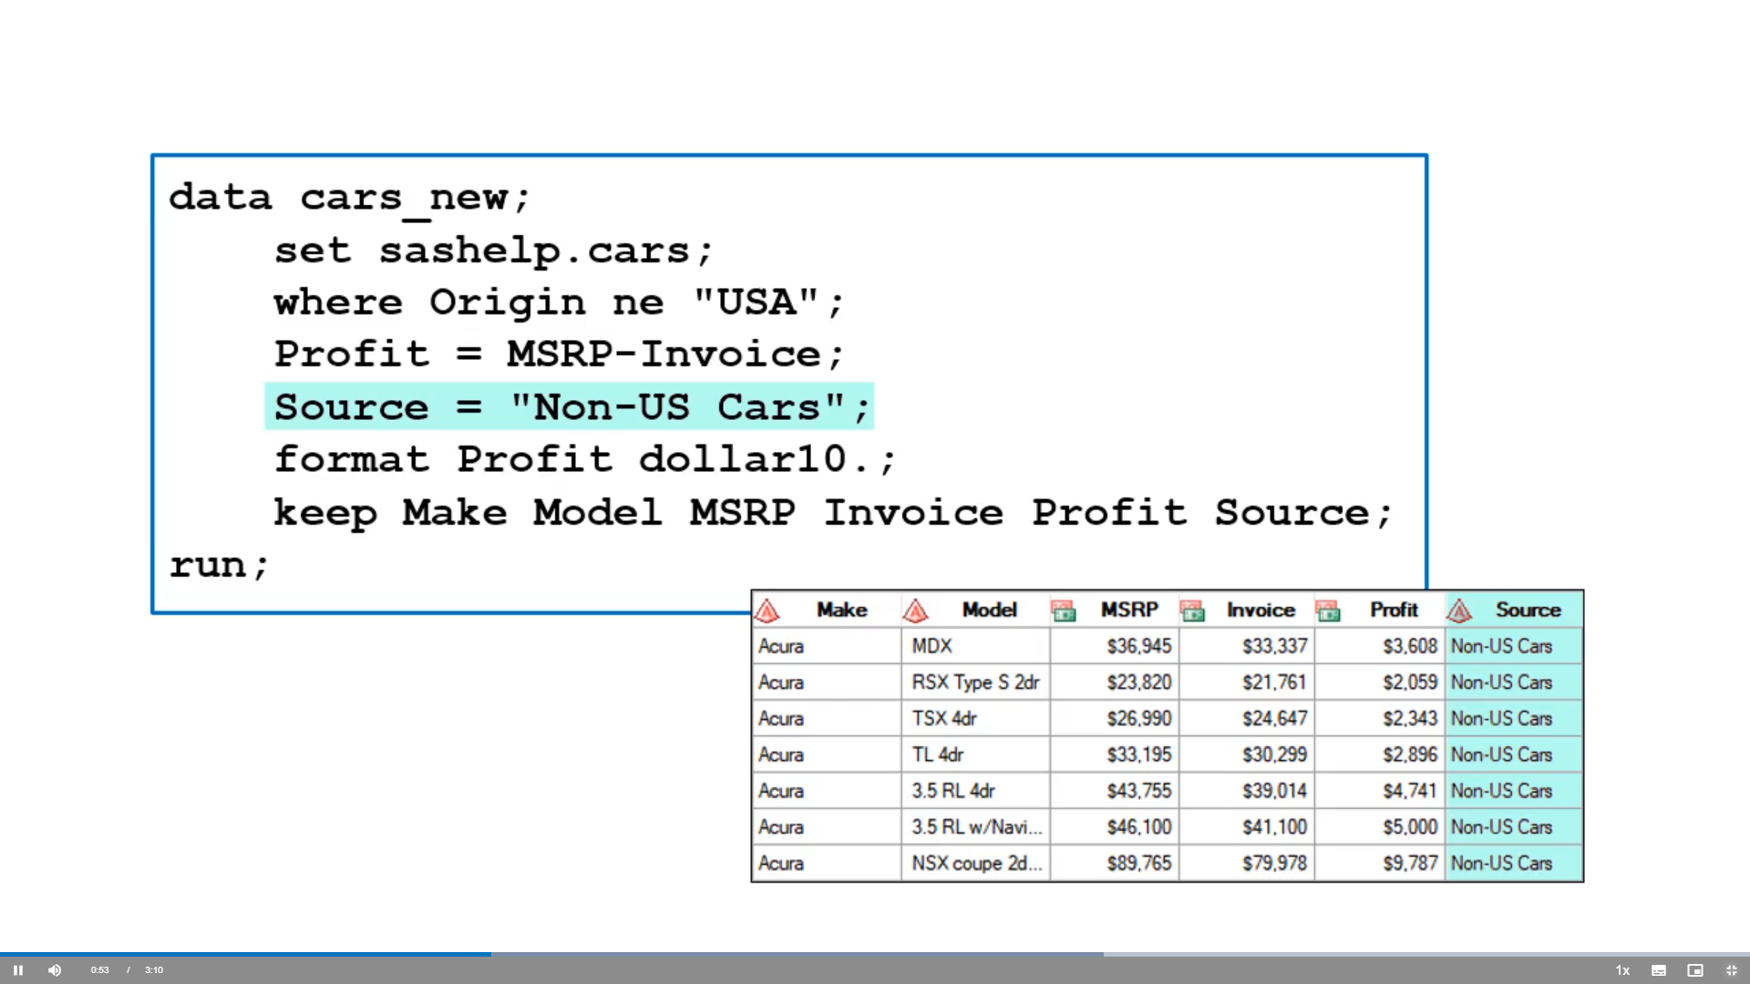

Slide 35
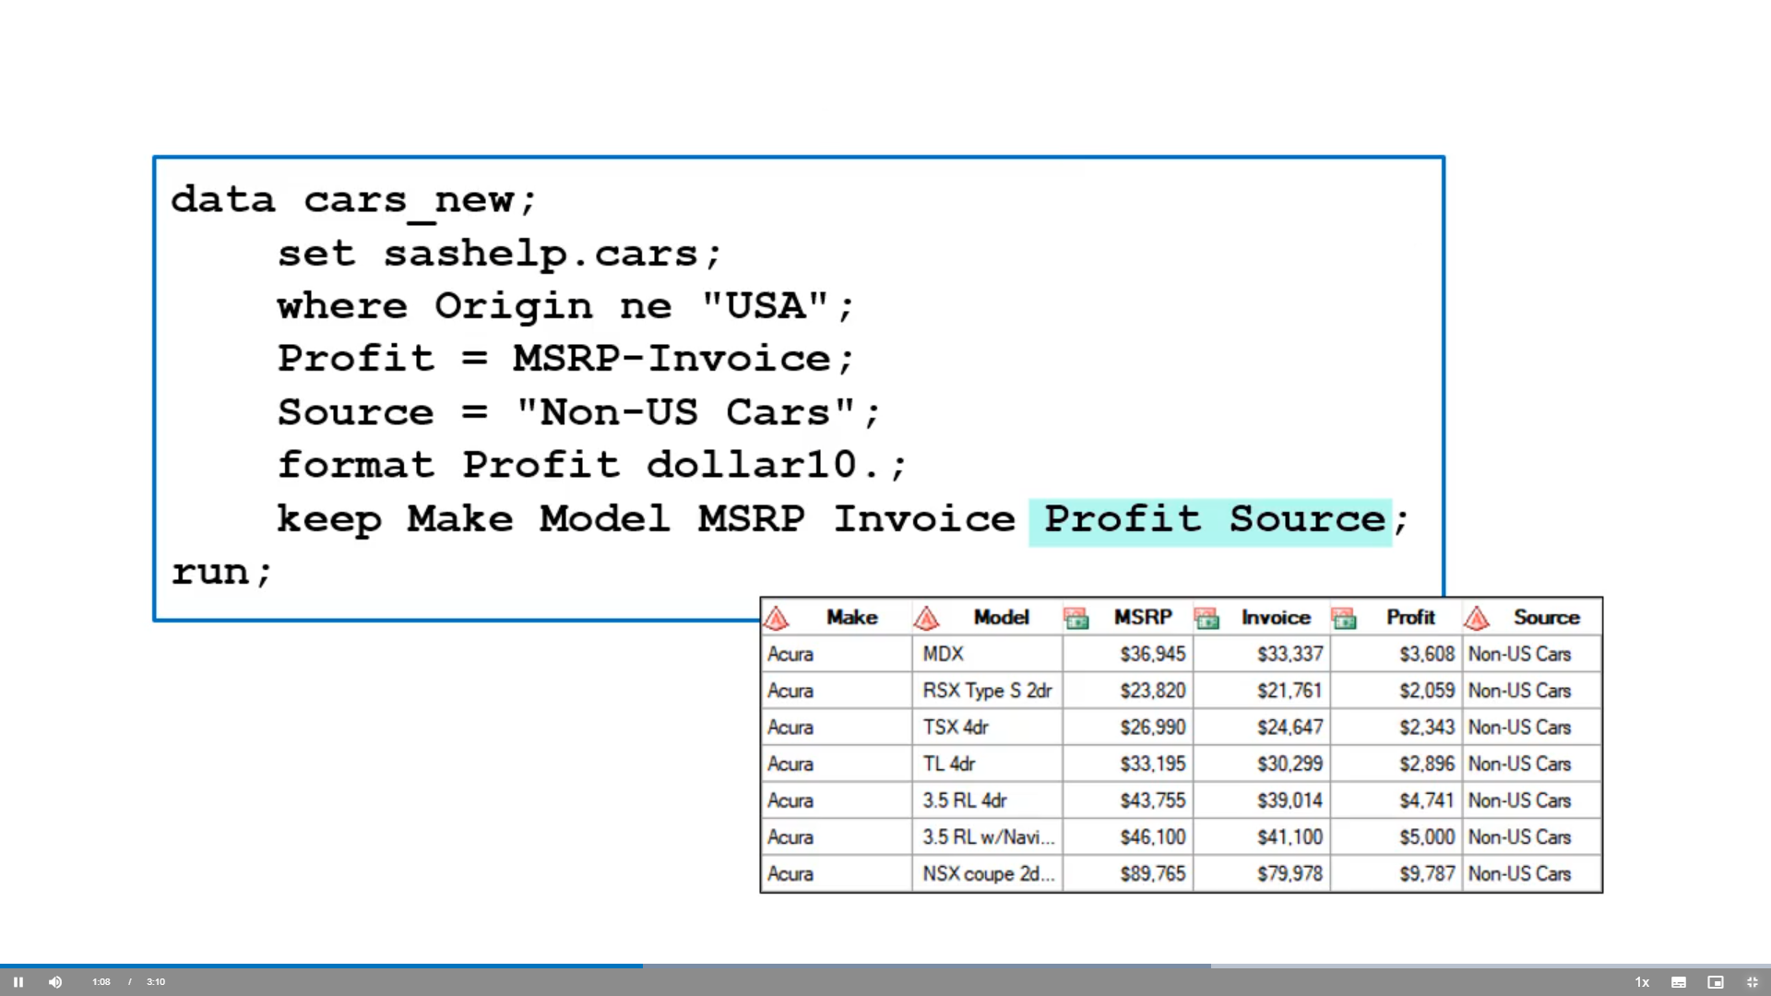

Slide 36
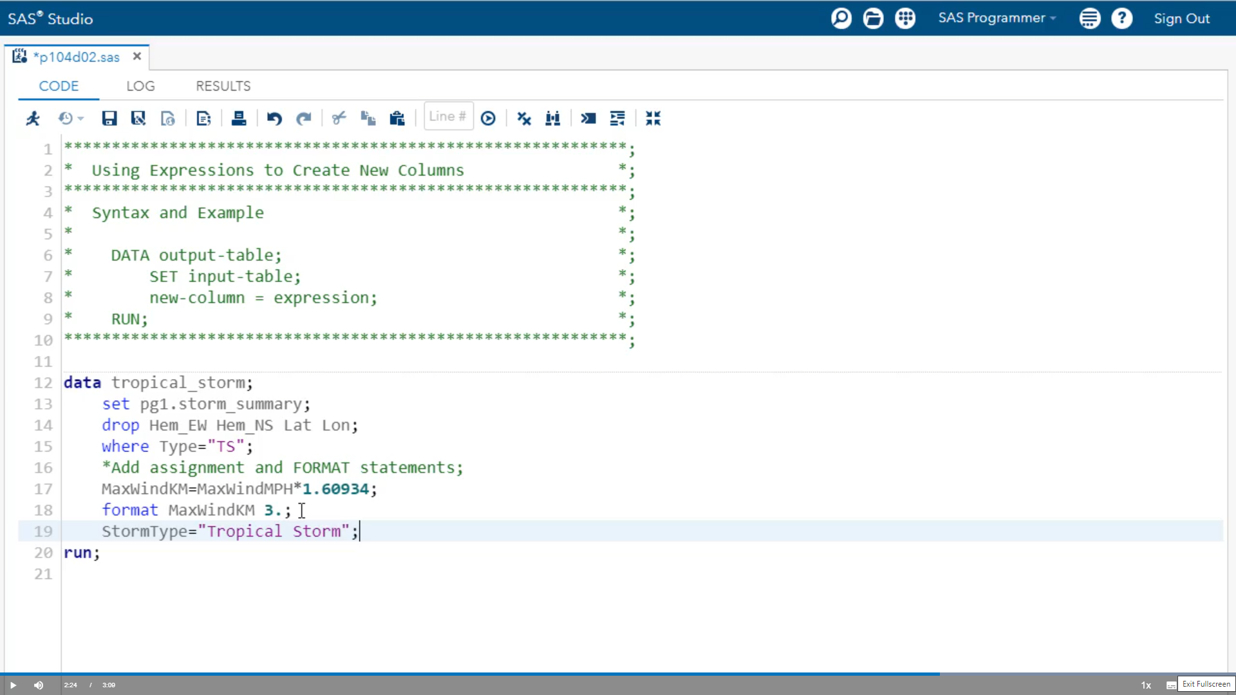

Slide 37
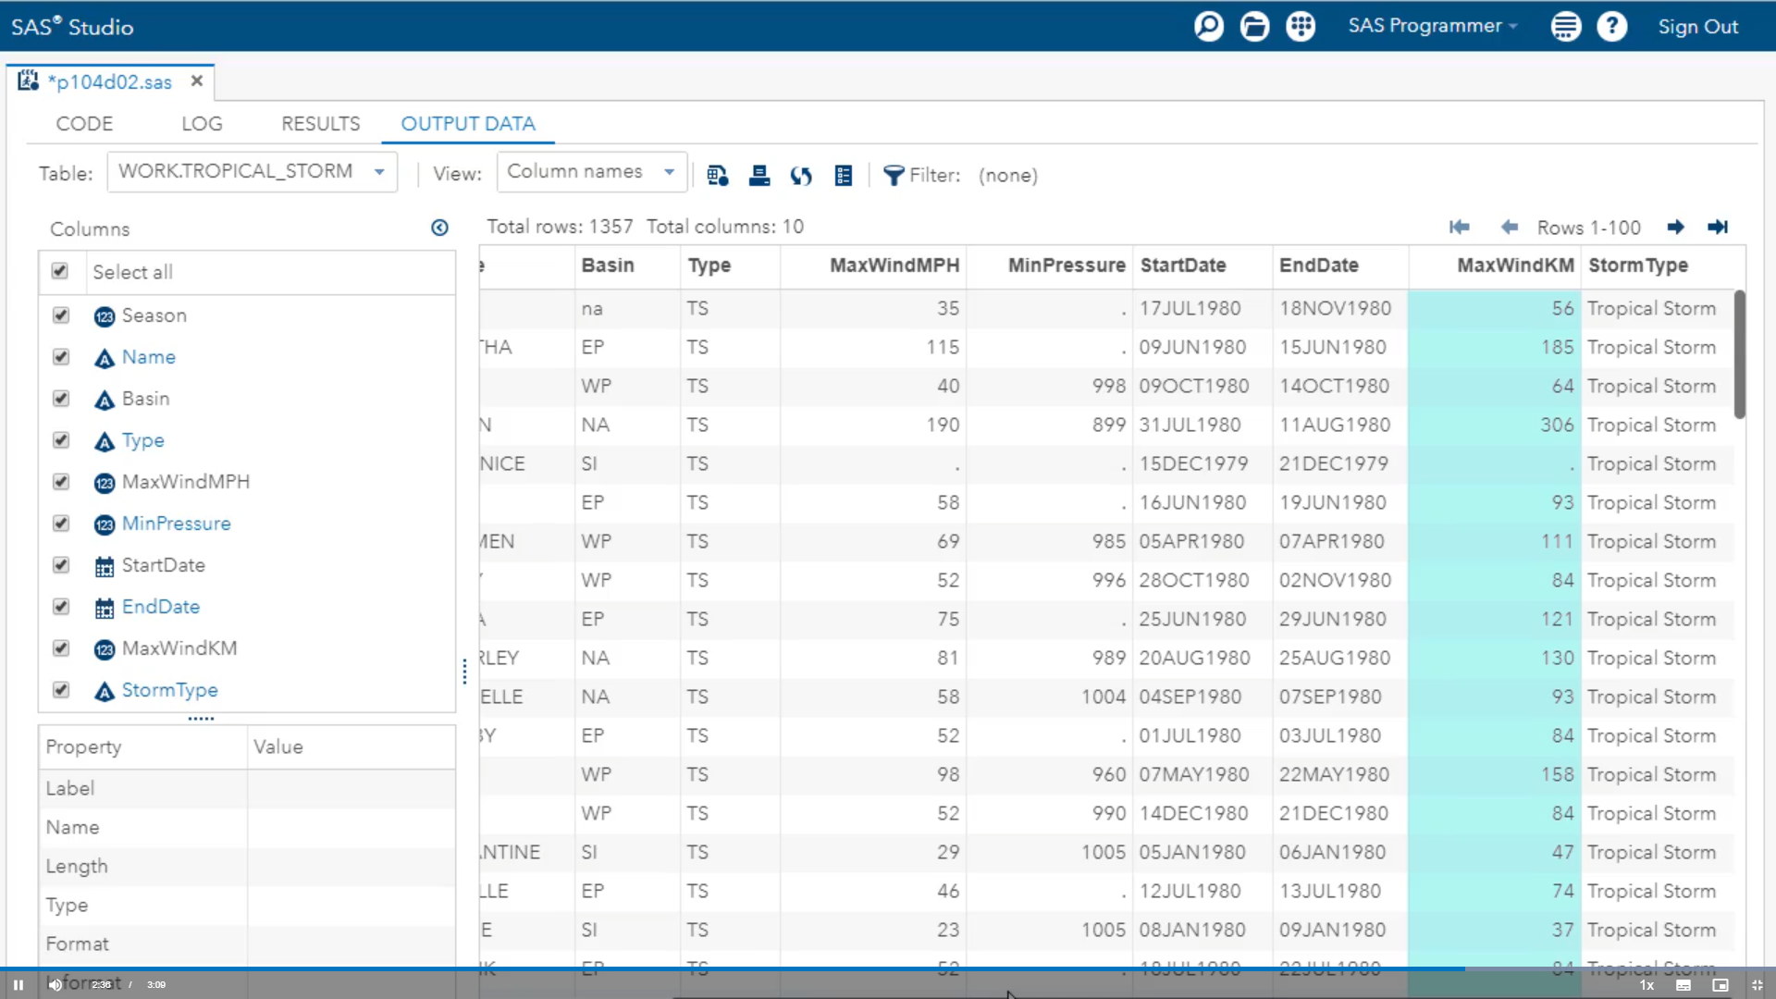

Slide 38
Activity
perform the following tasks:
Create Data Set as storm_length from XLSTROM>Strom_Summary and add an assignment statement to create StormLength that represents the number of days between StartDate and EndDate.
drop Hem_EW Hem_NS lat lon columns
Run the program.
In 1980, how long did the storm named Agatha last?

Slide 39
Ans:
data storm_length;
set pg1.storm_summary;
drop Hem_EW Hem_NS lat lon;
StormLength = EndDate-StartDate;
run;
The storm named Agatha lasted 6 days in 1980.

Slide 40
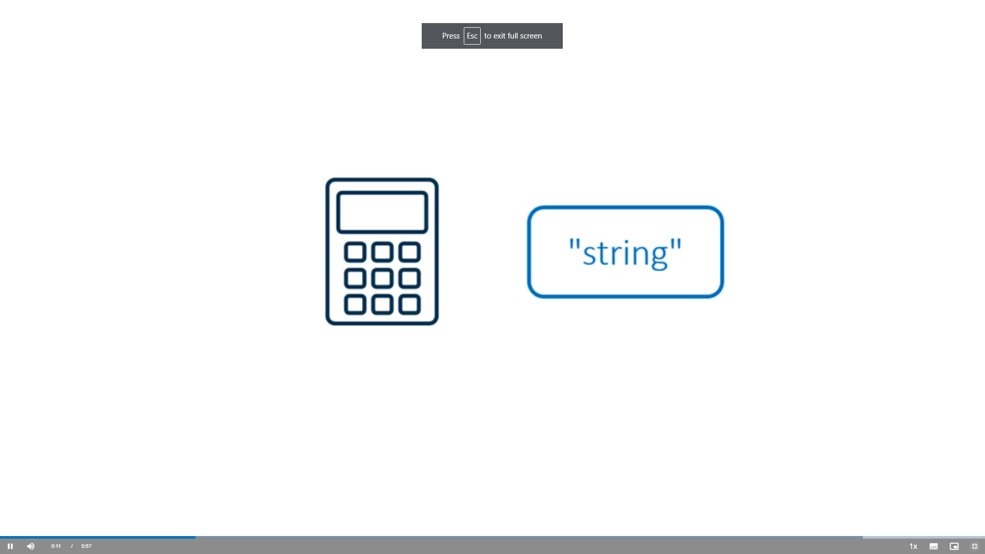
Using Numeric Functions to Create Columns

Slide 41
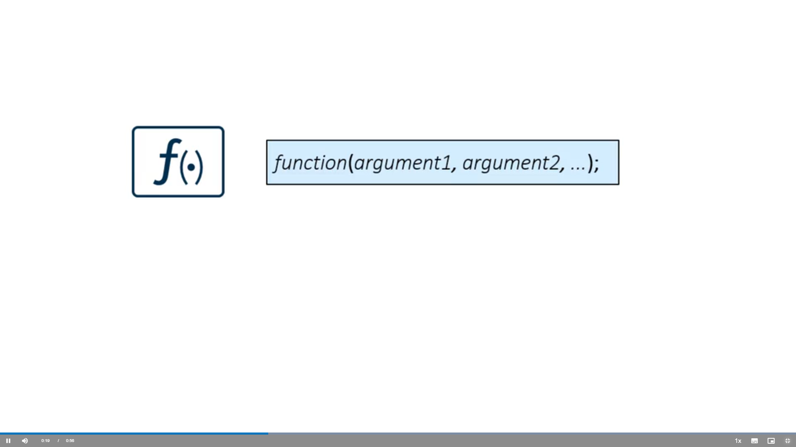

Slide 42
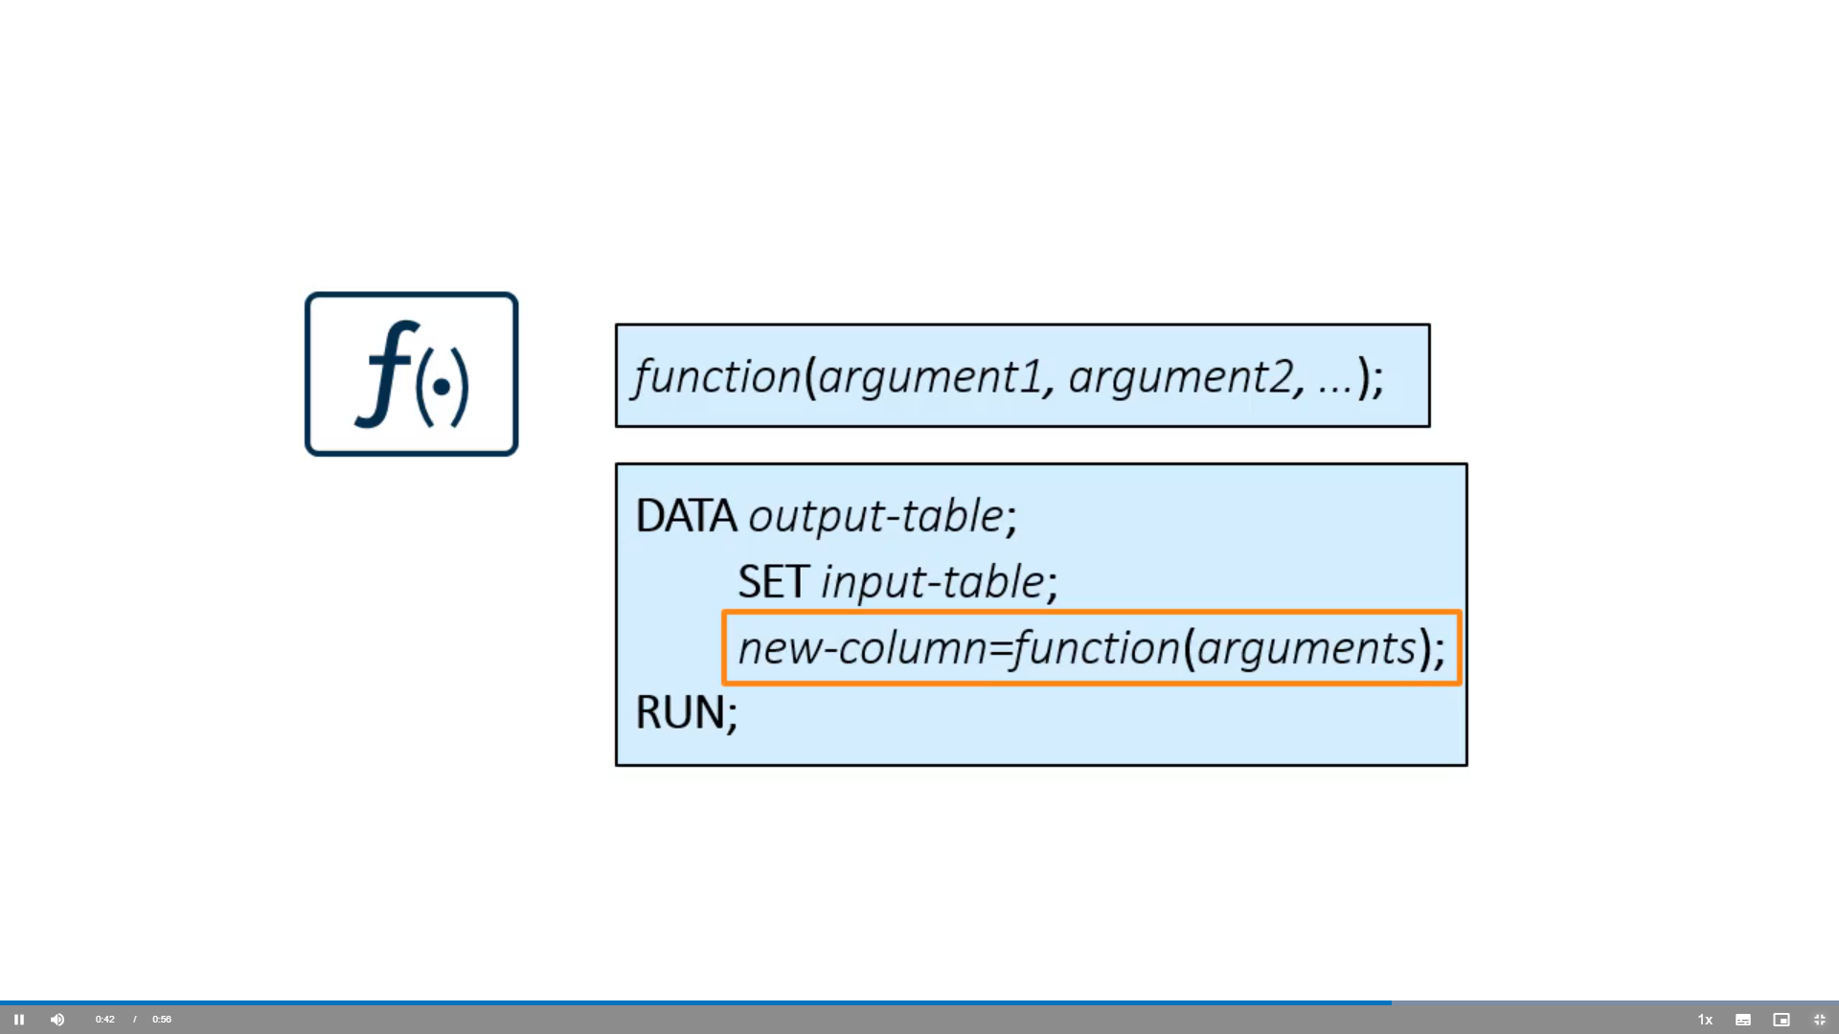

Slide 43
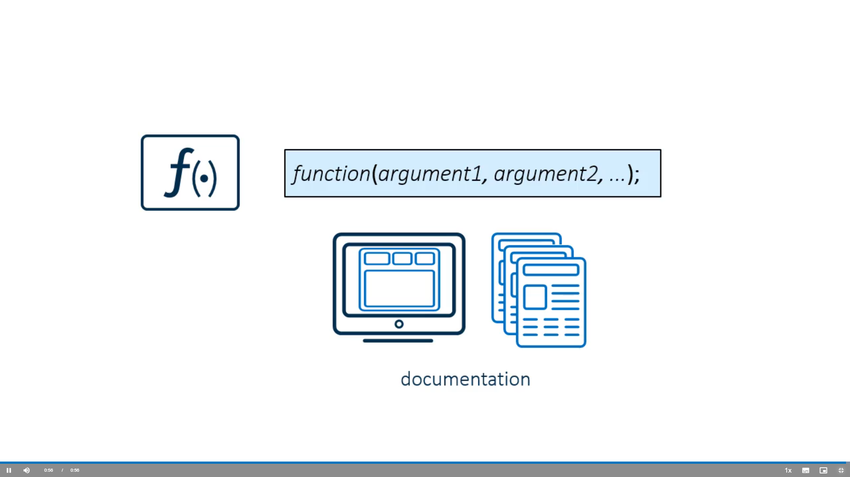

Slide 45
Activity
Perform the following tasks:
Open the XLSTROM.storm_range table and examine the columns. Notice that there are four wind measurements for each storm.
Create a new column named WindAvg that is the mean of wind1, wind2, wind3, and wind4.
Create a new column WindRange that is the range of wind1, wind2, wind3, wind4.
Run the program and view the data.
What are the WindAvg and WindRange values in row 1?

Slide 46
data storm_windavg;
set XLSTROM.storm_range;
WindAvg=mean(wind1, wind2, wind3, wind4);
WindRange=range(of wind1-wind4);
run;
Note: you can use the shorthand notation OF col1 - coln to list a range of columns when the columns have the same name and end in a consecutive number.
The WindAvg is 92.5 and the WindRange is 15.

Slide 47
Common Character Functions for Creating Columns

Slide 48
Demo: Using Character Functions

Slide 49
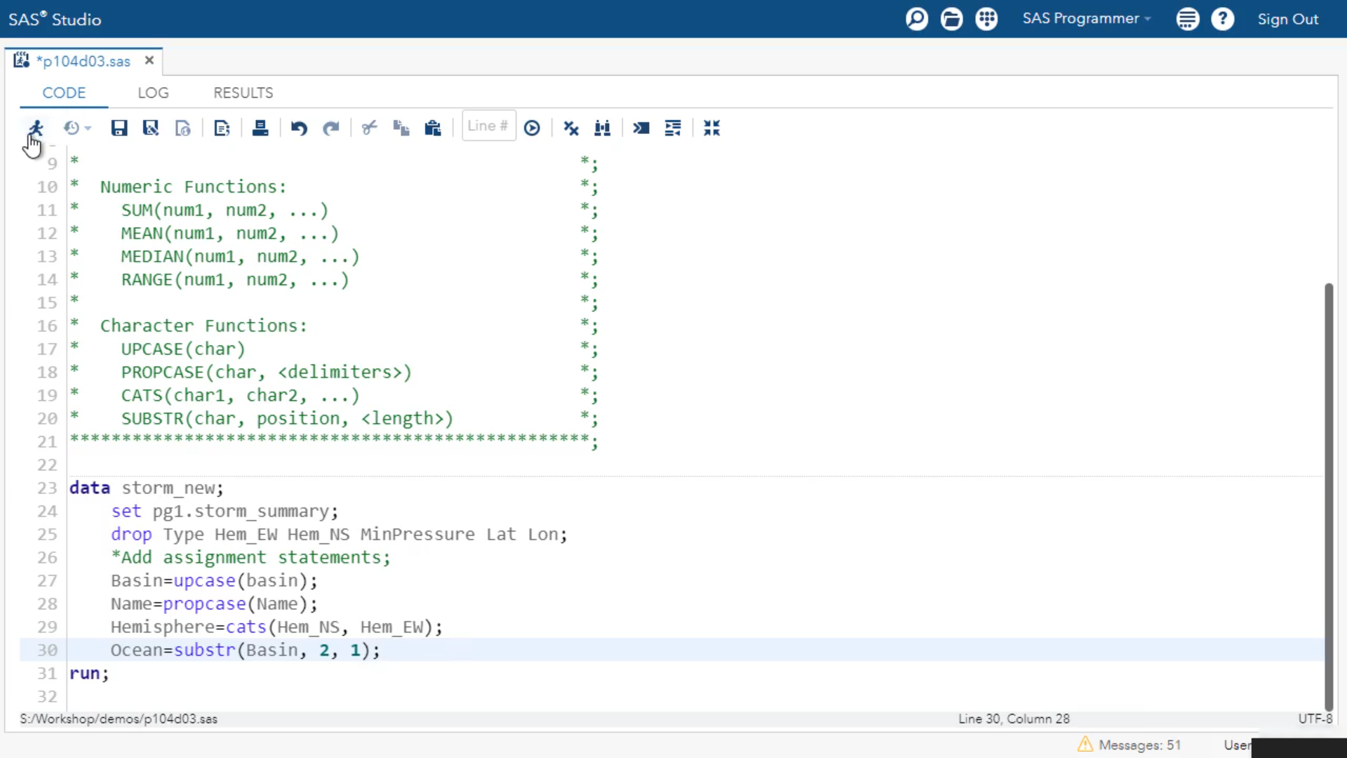

Slide 50
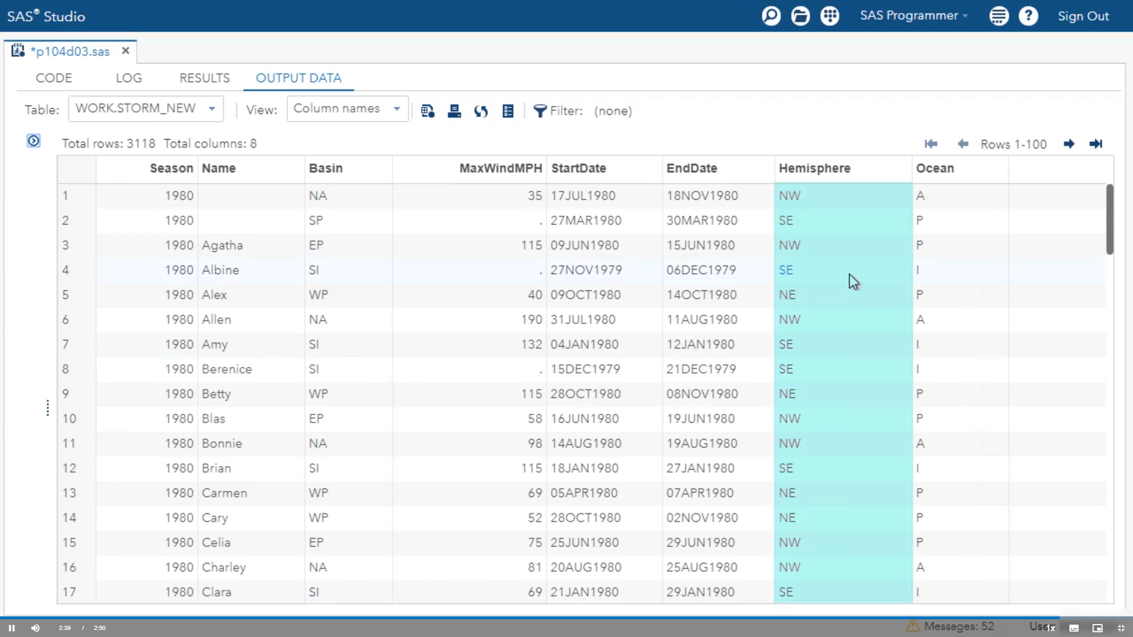

Slide 51
Activity
Perform the following tasks:
Add a WHERE statement that uses the SUBSTR function to include rows where the second letter of Basin is P (Pacific ocean storms).
Run the program and view the log and data.
How many storms were in the Pacific basin?

Slide 52
data pacific;
set pg1.storm_summary;
drop type Hem_EW Hem_NS MinPressure Lat Lon;
where substr(Basin,2,1)="P";
run;
A note in the log indicates that work.pacific has 1958 observations, so there were 1958 storms in the Pacific basin.

Slide 53
Common Date Functions for Creating Columns

Slide 54
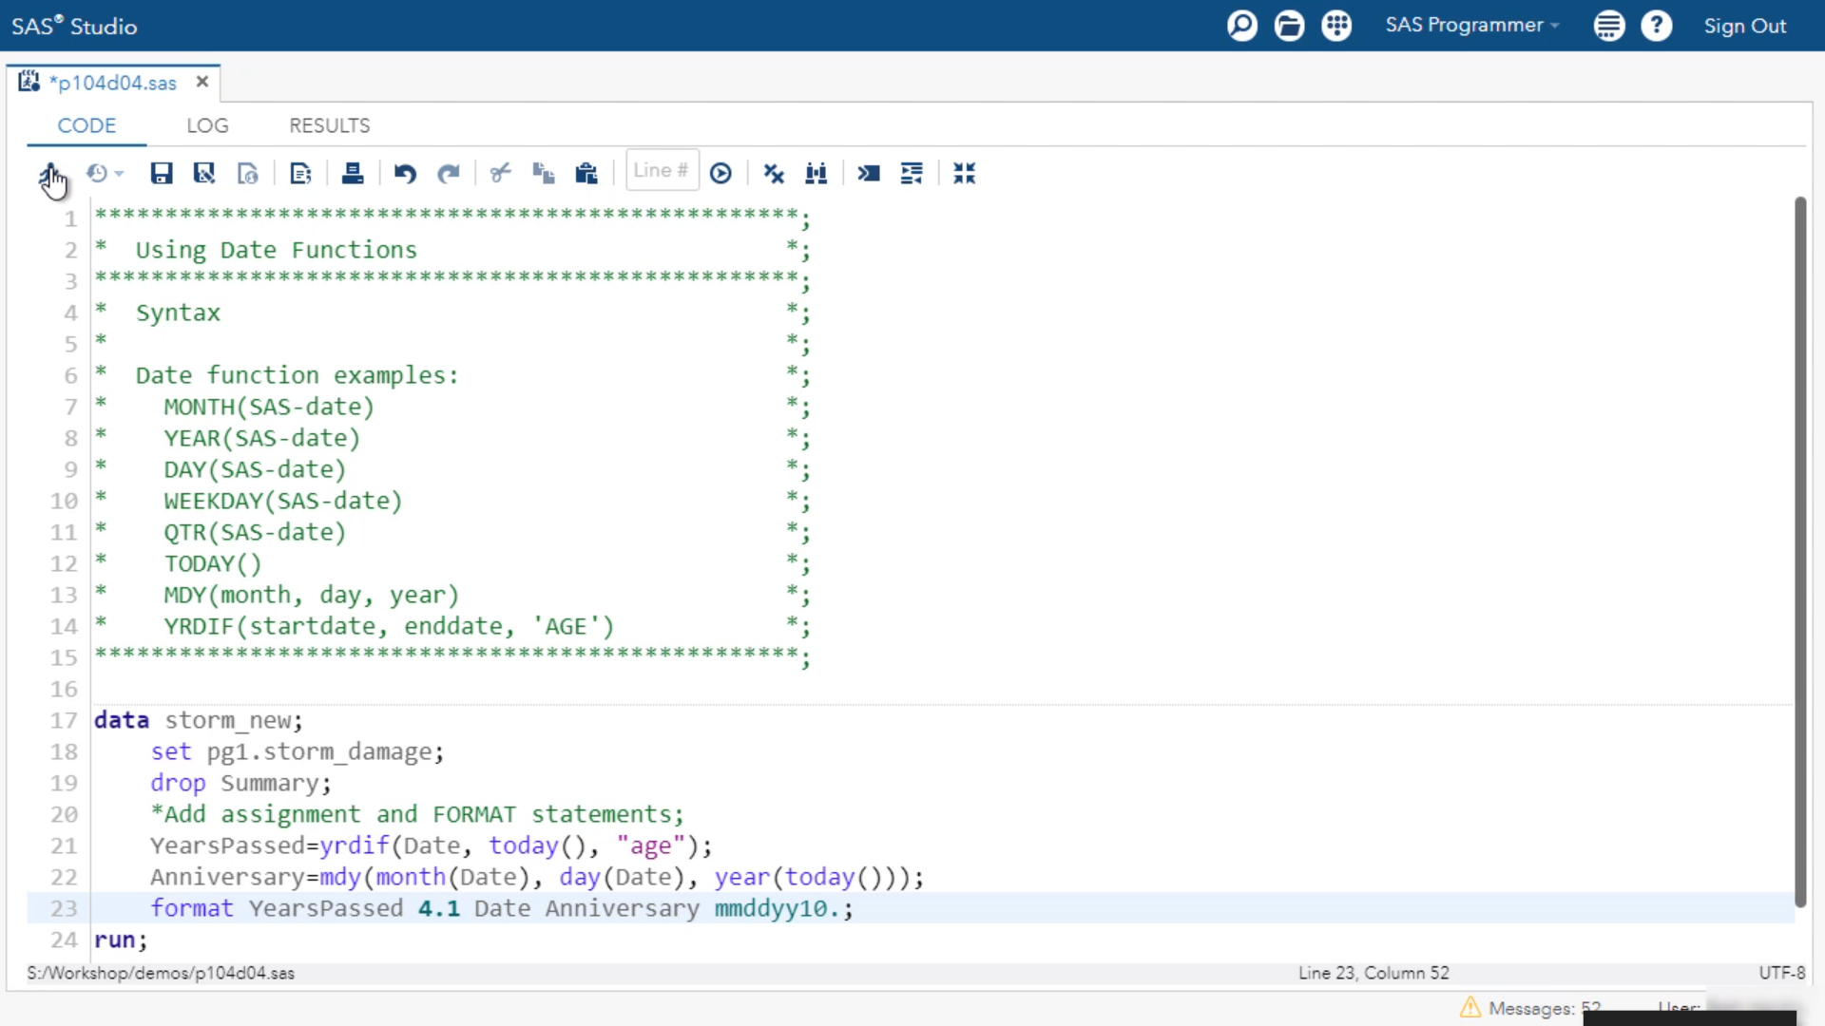
Demo: Using Date Functions

Slide 55
